Slide 1
This project has received funding from the European Union’s Horizon 2020 Research and Innovation programme under Grant Agreement No 769392
The hybrid exercise
Fabio Russo | Costruzioni Aeronautiche Tecnam SpA

Slide 2
This project has received funding from the European Union’s Horizon 2020 Research and Innovation programme under Grant Agreement No 769392
PAYLOAD
PERFORMANCES
ECONOMIA
sono (e saranno sempre) i drivers del mercato General Aviation
I velivoli in produzione e quelli gia’ in esercizio continueranno a volare per decenni
Il ricambio generazionale verso configurazioni (anche aerodinamiche) innovative, sebbene affascinante, non sara’ mai rapido come quello dell’automotive…
Offrire soluzioni retrofittabili, eco-sostenibili e convenienti nel breve-medio termine e’ la strada scelta da Tecnam con il programma H3PS
…ma sarà almeno conveniente???

Slide 3
This project has received funding from the European Union’s Horizon 2020 Research and Innovation programme under Grant Agreement No 769392
Configurazioni motopropulsive «di moda»...
Full electric
Ibrido in serie
Ibrido in parallelo

Slide 4
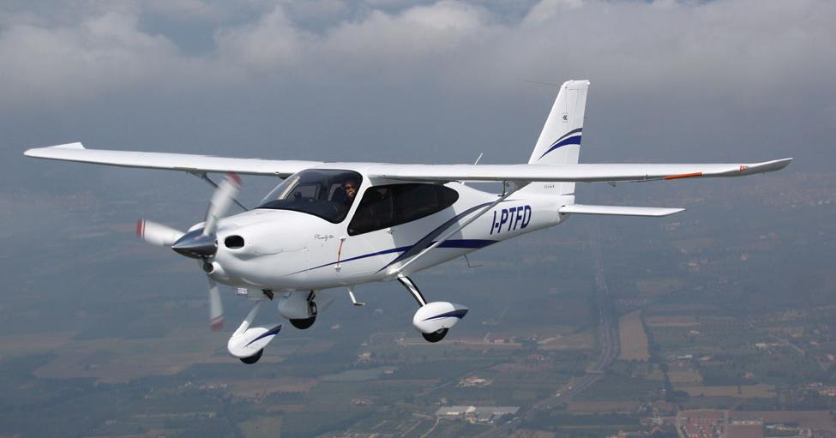
This project has received funding from the European Union’s Horizon 2020 Research and Innovation programme under Grant Agreement No 769392
...Test bed: il Tecnam P2010 di serie...
Quattro posti con motore a pistoni Lycoming da 180hp, il P2010 è rappresentativo di una intera categoria di velivoli costruiti a partire dagli anni ‘60 che oggi conta centinaia di migliaia di esemplari volanti
Peso gruppo propulsore = 185kg
Peso impianto carburante = 5kg
Peso della batteria velivolo + accessori = 20kg
Peso del velivolo
«pronto per essere rimotorizzato»
520kg

Slide 5
This project has received funding from the European Union’s Horizon 2020 Research and Innovation programme under Grant Agreement No 769392
...e postulati...
Peso «vuoto» pronto ad ospitare una rimotorizzazione: 520kg
Peso Massimo al Decollo = 1160kg
Potenza minima richiesta al decollo = 170hp (125kW)
Potenza richiesta in crociera =
power | Power | Speed
77% | 102kW | 122 kTAS
60% | 78kW | 108 kTAS
50% | 66kW | 98 kTAS
Endurance minima = 3hr (+6min per T/O&Climb)

Slide 6
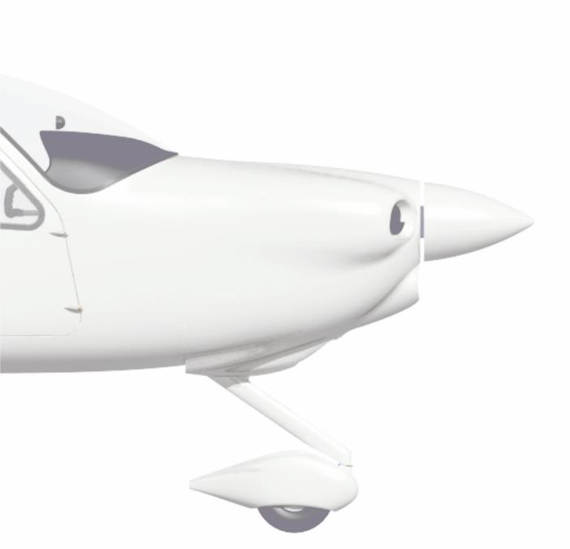
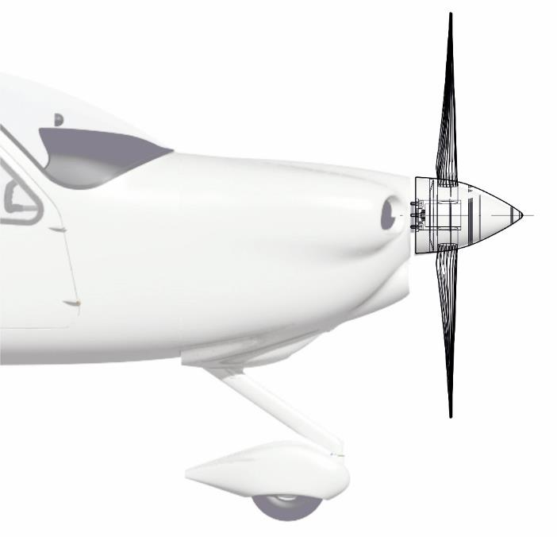
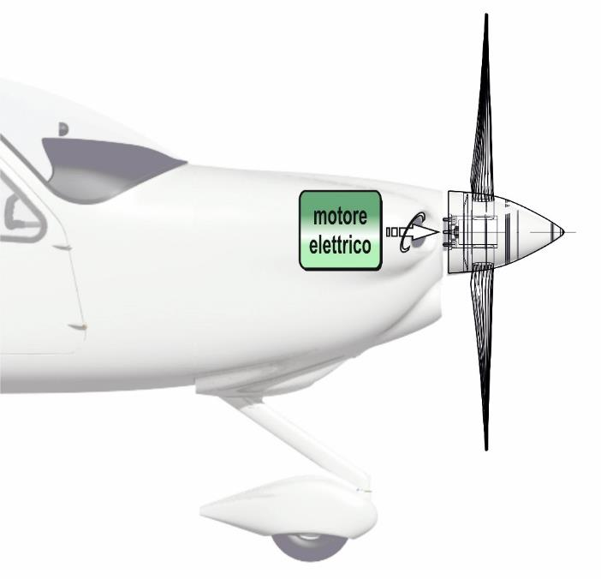
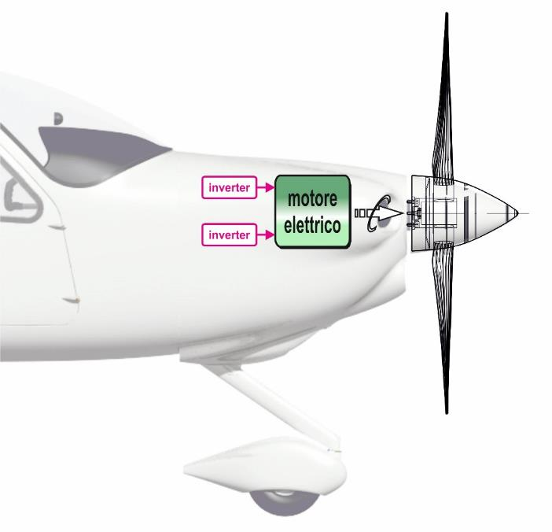
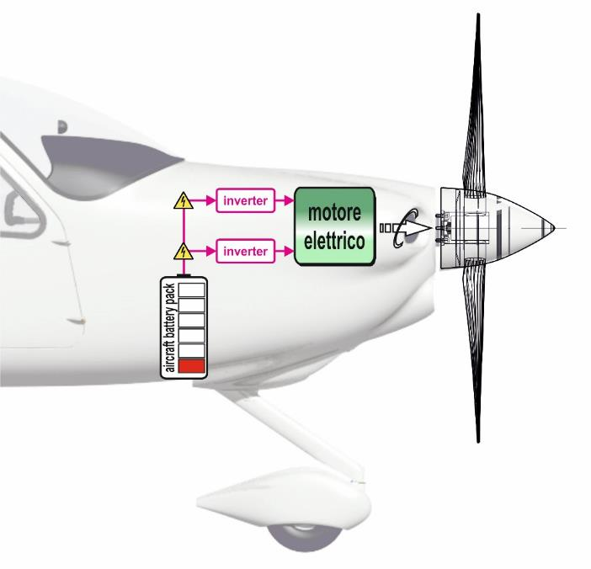
This project has received funding from the European Union’s Horizon 2020 Research and Innovation programme under Grant Agreement No 769392
Esercizio N.1: costruiamo un P2010 «full electric»!!
$$\frac{125kW}{0,93}∙0,1h=13,4kWh$$
Motore elettrico: 24kg
Inverters: 12kg
$$+$$
Batterie da 300Wh/kg:
755kg
$$\frac{66kW}{0,93}∙3h=213kWh$$
Cavi, LRU ecc…: 30kg
Massa velivolo: 520kg
$$TOTALE=226,4kWh$$
$$226,4kWh∙\frac{kg}{0,3kWh}=755kg!$$
Massa TOT. senza payload: 1341kg

Slide 7
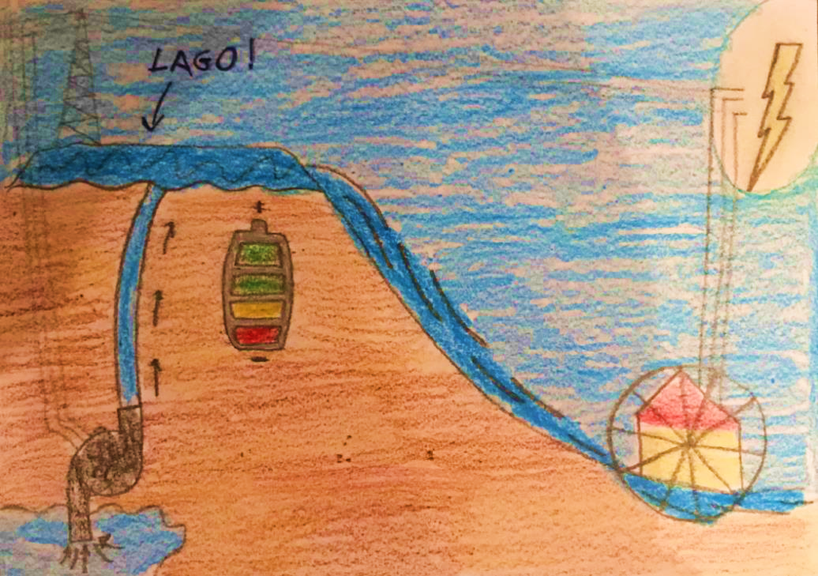
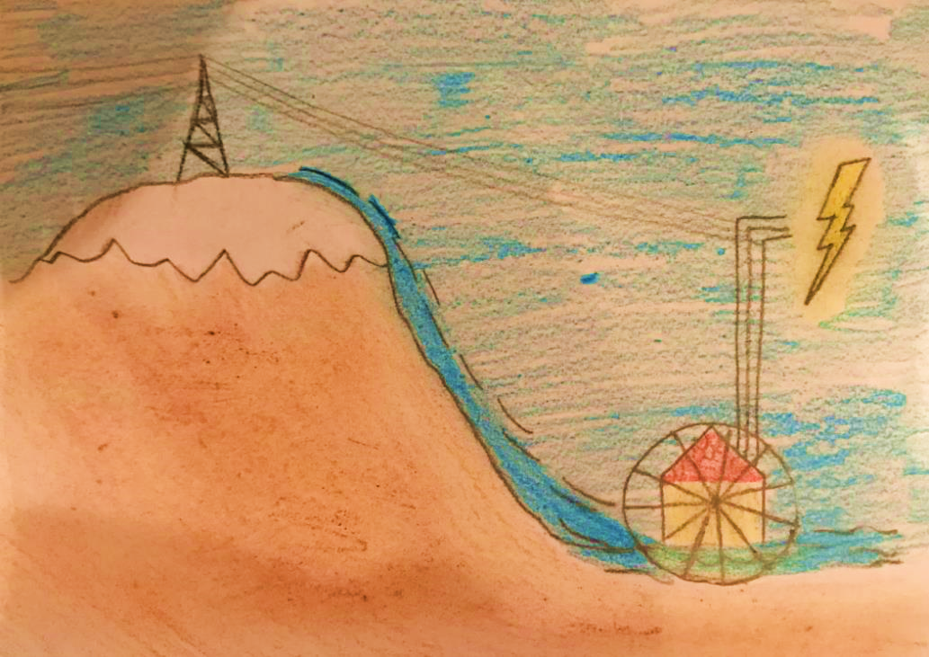
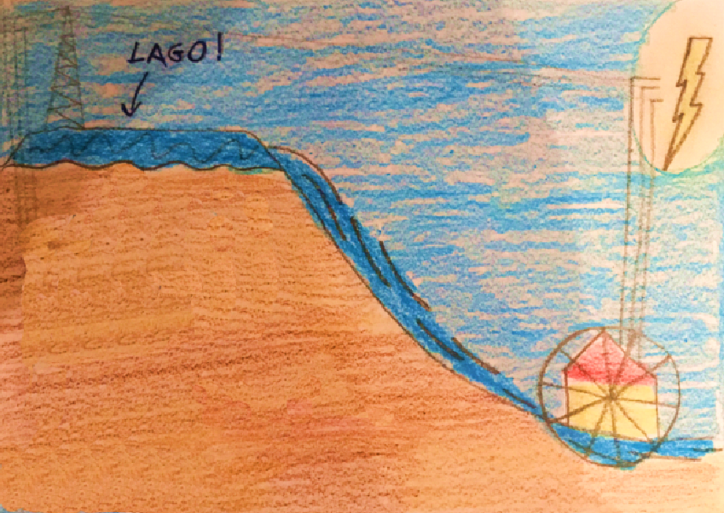
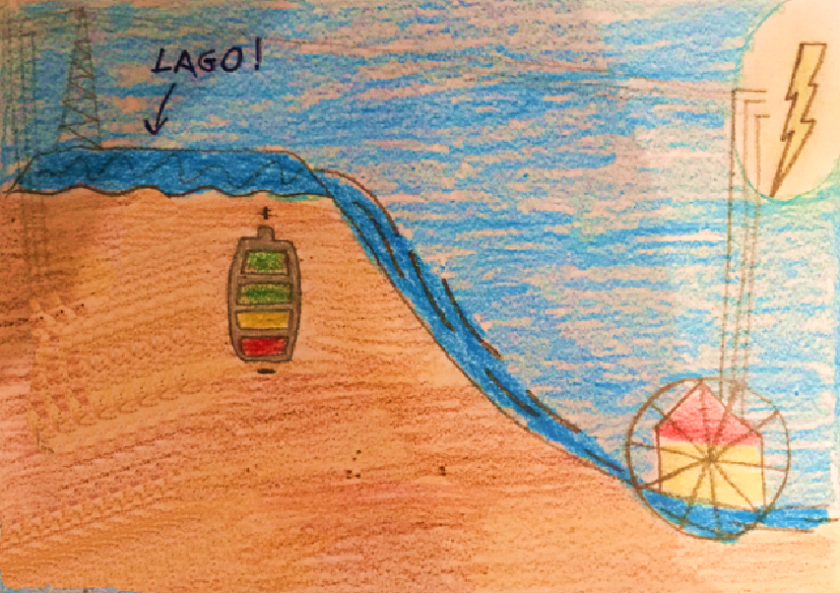
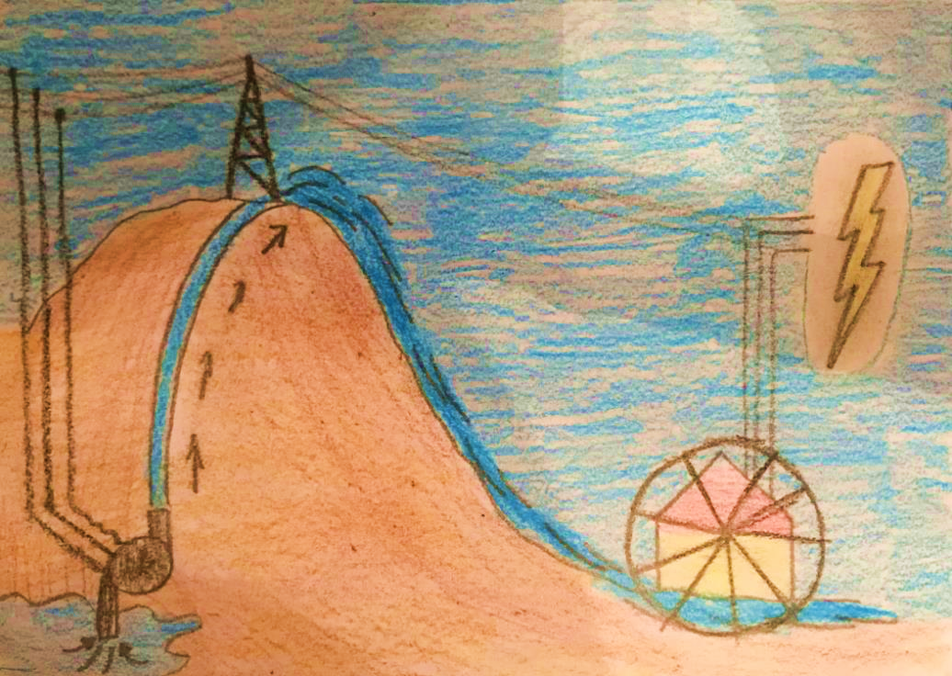
This project has received funding from the European Union’s Horizon 2020 Research and Innovation programme under Grant Agreement No 769392
...come nasce il passaggio ai concetti di ibrido ?

Slide 8
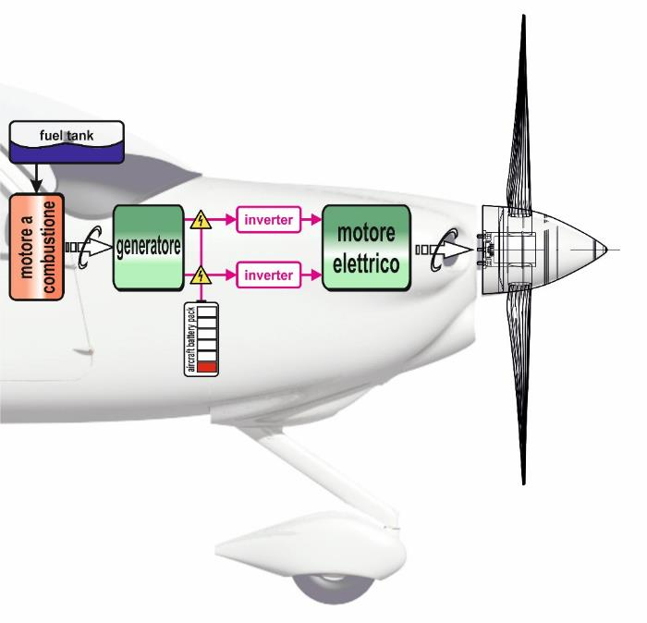
This project has received funding from the European Union’s Horizon 2020 Research and Innovation programme under Grant Agreement No 769392
-11%
Motore elettrico (125kW): 24kg
95%
98%
95%
Inverters: 12kg
Batterie (T/O+Climb, 200wh/kg): 62kg
Generatore: 15kg
Motore a combustione: 105kg
Cavi, LRU ecc…: 40kg
Fuel weight (T/O + chrg. + Cruise): 0+5+58kg
Massa velivolo: 520kg
Massa TOT. senza payload: 841kg
74kW
69kW
66kW
Payload: 320kg
70kW
Payload attuale (Lycoming): 370kg

Slide 9
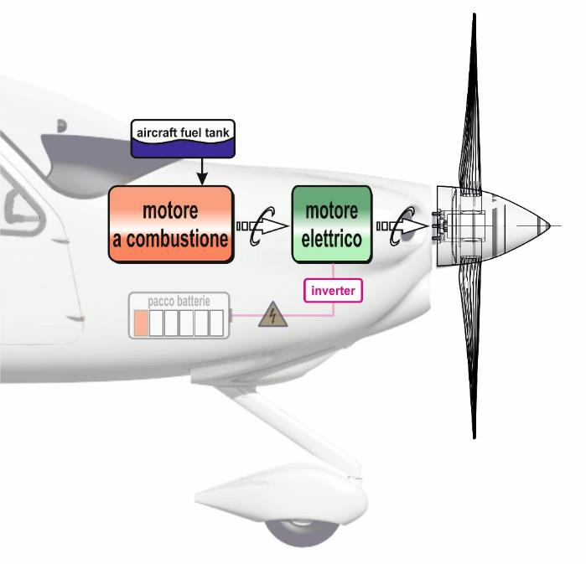
This project has received funding from the European Union’s Horizon 2020 Research and Innovation programme under Grant Agreement No 769392
Motore elettrico (41kW): 10kg
41kW
Inverter (uno soltanto): 6kg
Batterie T/O+Climb, 200wh/kg): 21kg
Motore a combustione: 105kg
Cavi, LRU ecc…: 20kg
Fuel weight (T/O + chrg. + Cruise): 0+2+50kg
Massa velivolo: 520kg
Massa TOT. senza payload: 734kg
125kW
Payload: 426kg
84kW
Payload attuale (Lycoming): 370kg

Slide 10
This project has received funding from the European Union’s Horizon 2020 Research and Innovation programme under Grant Agreement No 769392
Breakdown | base | electric | Series HY. | Parallel
TOTALE PAYLOAD DISPONIBILE | 370kg | 0,0 | 319kg | 426kg
TOTALE CARB. CONSUMATO | 83lt | 0,0 | 88lt | 72lt

Slide 11
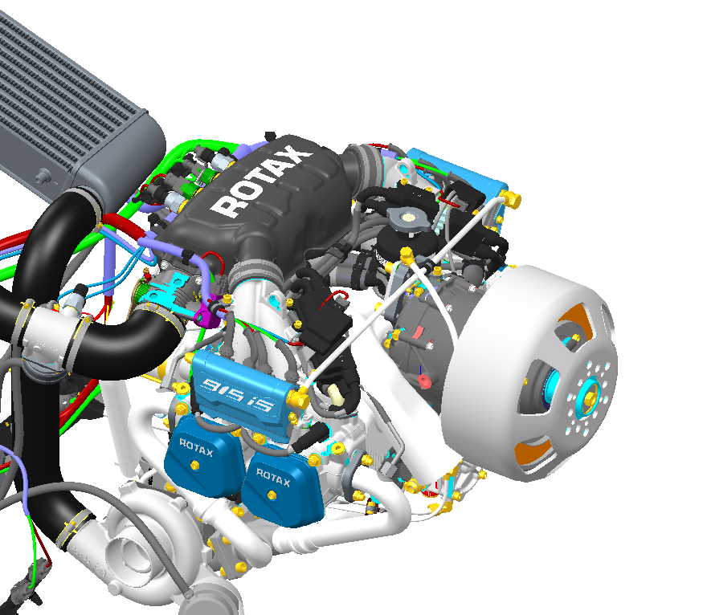
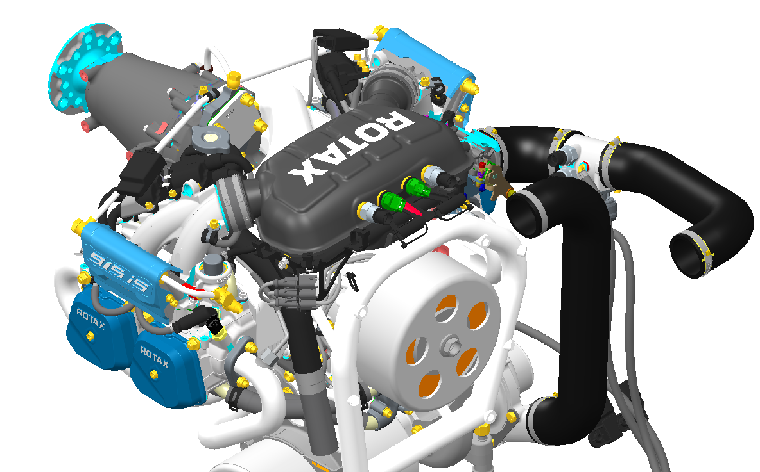
This project has received funding from the European Union’s Horizon 2020 Research and Innovation programme under Grant Agreement No 769392

Slide 12
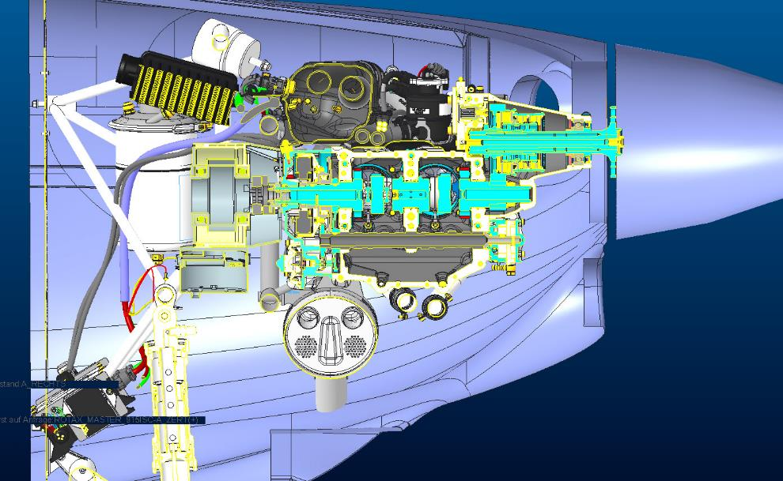
This project has received funding from the European Union’s Horizon 2020 Research and Innovation programme under Grant Agreement No 769392

Slide 13
This project has received funding from the European Union’s Horizon 2020 Research and Innovation programme under Grant Agreement No 769392
Grazie a tutti!

