Slide 1
Digital Optics and Machine Learning algorithms for
Aircraft Maintenance
Salvatore Merola
Ph.D. student in Industrial Engineering
salvatore.merola@unina.it|savimerola@outlook.it
Department of Industrial Engineering
University of Naples Federico II
Via Claudio 21, 80125, Naples, IT

Slide 2
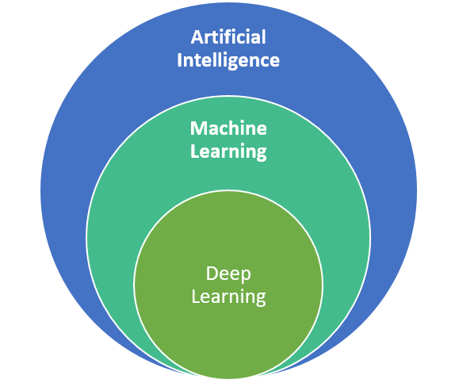
Artificial Intelligence, Machine learning, Deep Learning,
Computer vision.
Computer vision

Slide 3
A little bit of history…

Slide 4
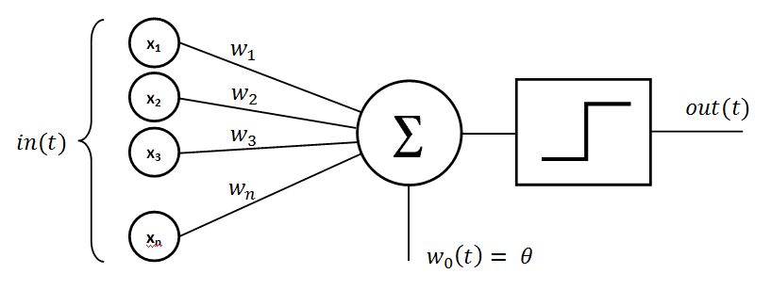
A little bit of history…
Early Beginnings (50s – 70s)
Rosenblatt’s Perceptron:

Slide 5
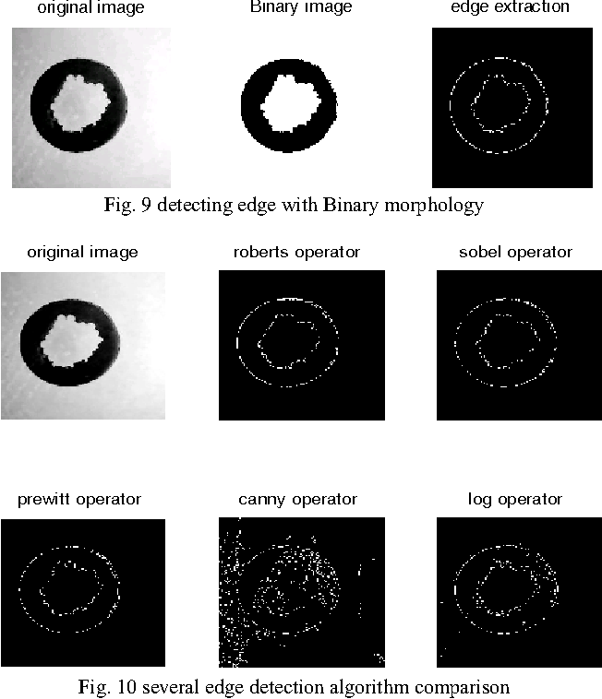
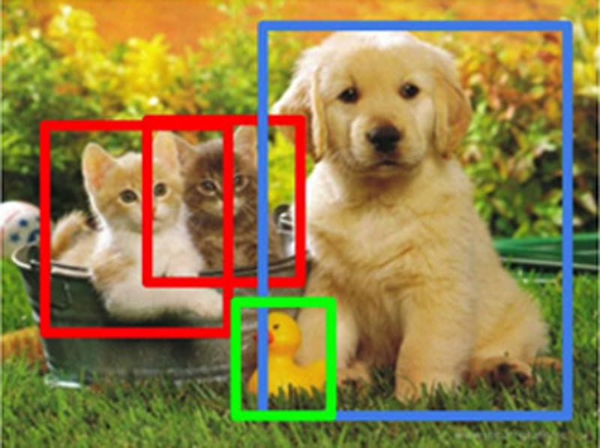
A little bit of history…
Edge detections and Feature extraction(70s – 2000)

Slide 6
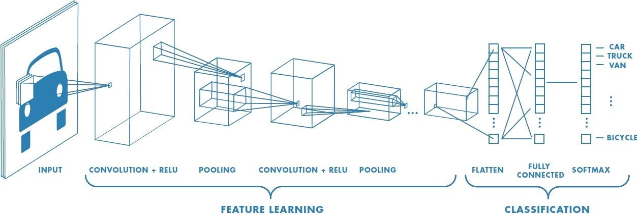
A little bit of history…
Deep Learning revolution (2000 - now)
Convolutional Neural Networks (AlexNet, VGGNet, ResNet, … , YOLO)

Slide 7
Computer vision

Slide 8
Computer vision
How does it work?
Image acquisition : How? What acquisition system to use? What kind of images am I going to analyze?
Pre-Processing : Analysis Preparation phase (Data Augmentation)
Noise Reduction
Image Enhancement
Resizing/Cropping
Normalization

Slide 9
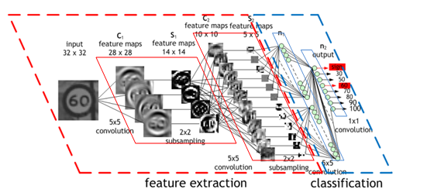
Computer vision
How does it work?
Feature Extraction and representation:
Edges,
Corners,
Textures,
Colors,
Shapes,
…

Slide 10
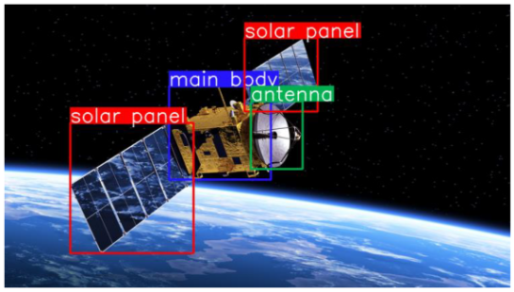
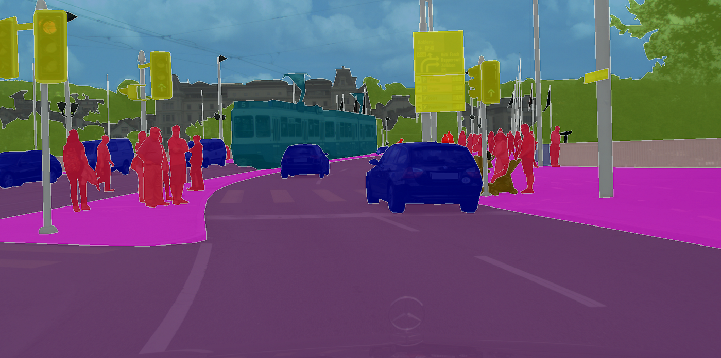
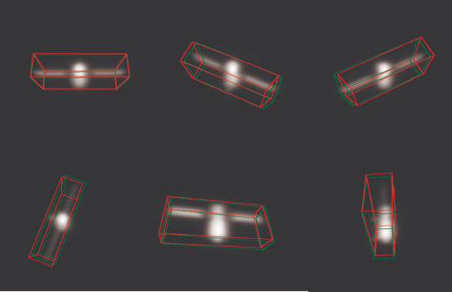
Computer vision
How does it work?
Deep Learning for Output Phase :
Object Detection
Image segmentation
Pose estimation

Slide 11
Areas of applications

Slide 12
Areas of applications
Technology fields
Automotive: Autonomous Vehicle (AV) , License Plate Recognition (LPR), …
Healthcare: medical images, diagnostic imaging, remote patient monitoring, …
Manufacturing: Quality control, Robotic automation, Predictive maintenance, …
Agriculture: Precision agriculture, livestock monitoring, pest control, …
…
And Aircraft field?

Slide 13
Application on Aircraft: Maintenance Tasks

Slide 14
Classical aircraft maintenance process
Aircraft maintenance processes
Maintenance Steering Groups (MSG) – 3 :
MSI determination (Maintenance Significant Items, critical components)
MSG-3 Analysis Level 1 (evaluating functional failure & possible consequences)
MSG-3 Analysis Level 2 (identifying possible maintenance actions)
Over 80% of inspections on large transport category aircraft are visual inspections. Small transport and general aviation aircraft rely on visual inspection techniques more heavily than large transport aircraft.
So in this presentation, visual inspection is the focus.

Slide 15
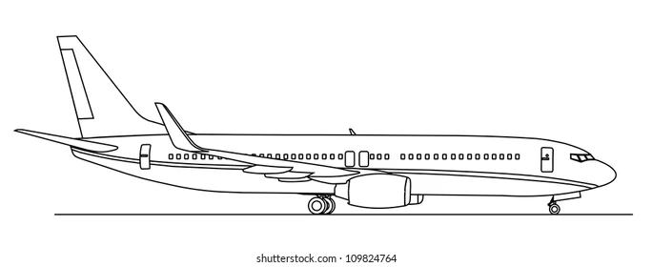
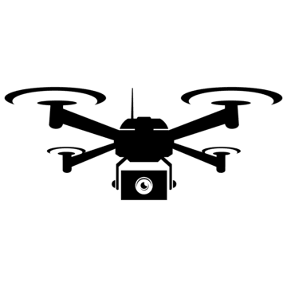
New aircraft maintenance process
Aircraft maintenance processes

Slide 16
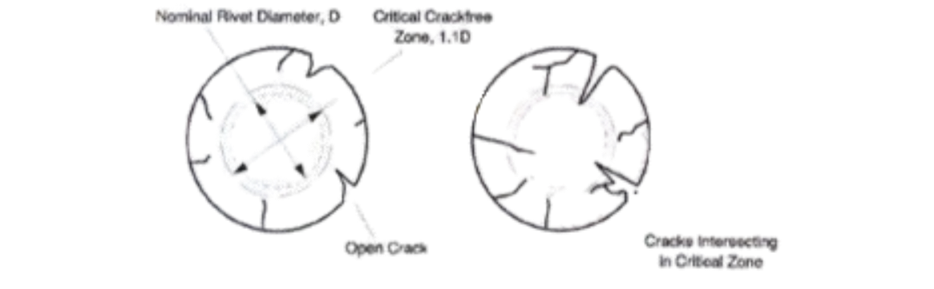
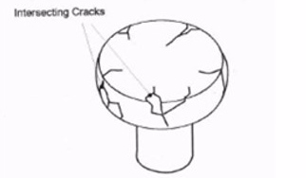
Acceptability criteria for rivets
Aircraft maintenance processes
From ref 51-11-11 Description Allowable Damage:
acceptable rivet when:
$$S_{nc }= π{(1.1 D)}^{2}$$
acceptable rivet when:
Cracks don’t cross on rivet’s head

Slide 17
Acceptability criteria for dents
Aircraft maintenance processes
From ref 51-11-13 Allowable Damage Limits for Dents - Generic:
So far, only dents complying with the regulations were captured.

Slide 18
Methodology

Slide 19
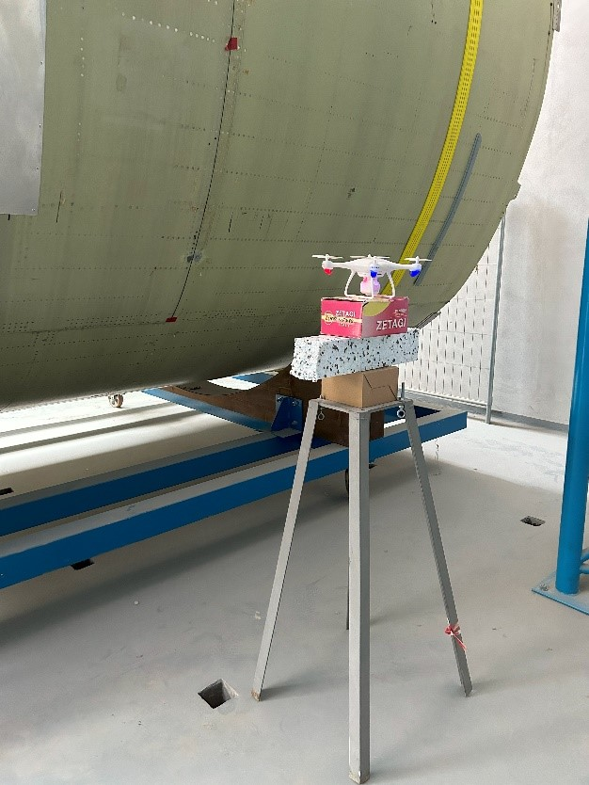
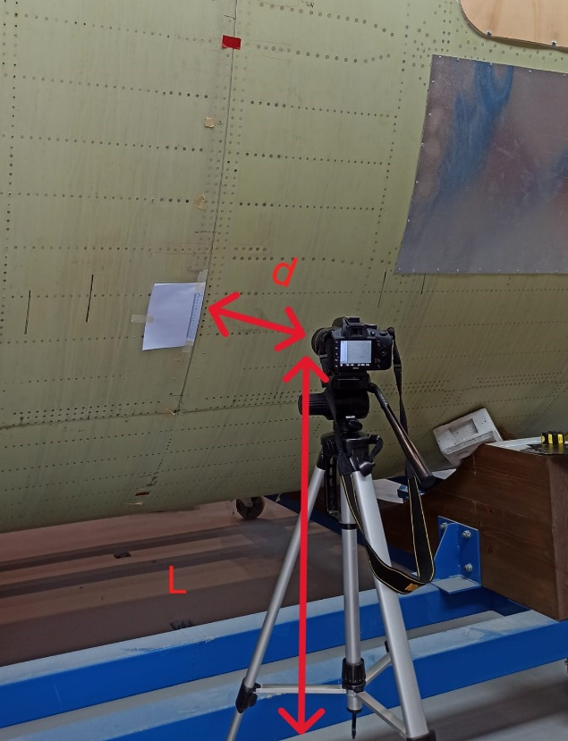
Digital optics trade-off phase
Methodology
 | Acquisition systems
 | Smartphone (12 MP) | Drone (4 MP) | Reflex (24 MP)
D = 65 cm
D = 75 cm
D = 85 cm
D = 100 cm
Red = Poor n. classifications
Yellow = Mediocre n. classifications
Green = Good n. classifications
Test with Drone as
acquisition system
Test with Reflex as
acquisition system

Slide 20
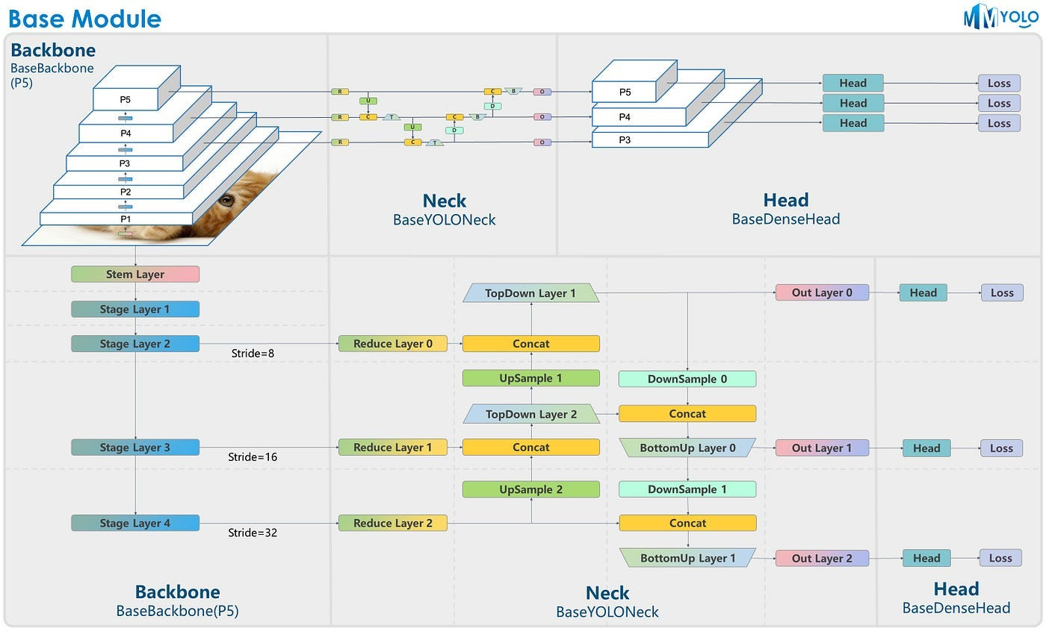
YOLO v8 architecture
You Only Look Once algorithm

Slide 21
Damage detection algorithm

Slide 22
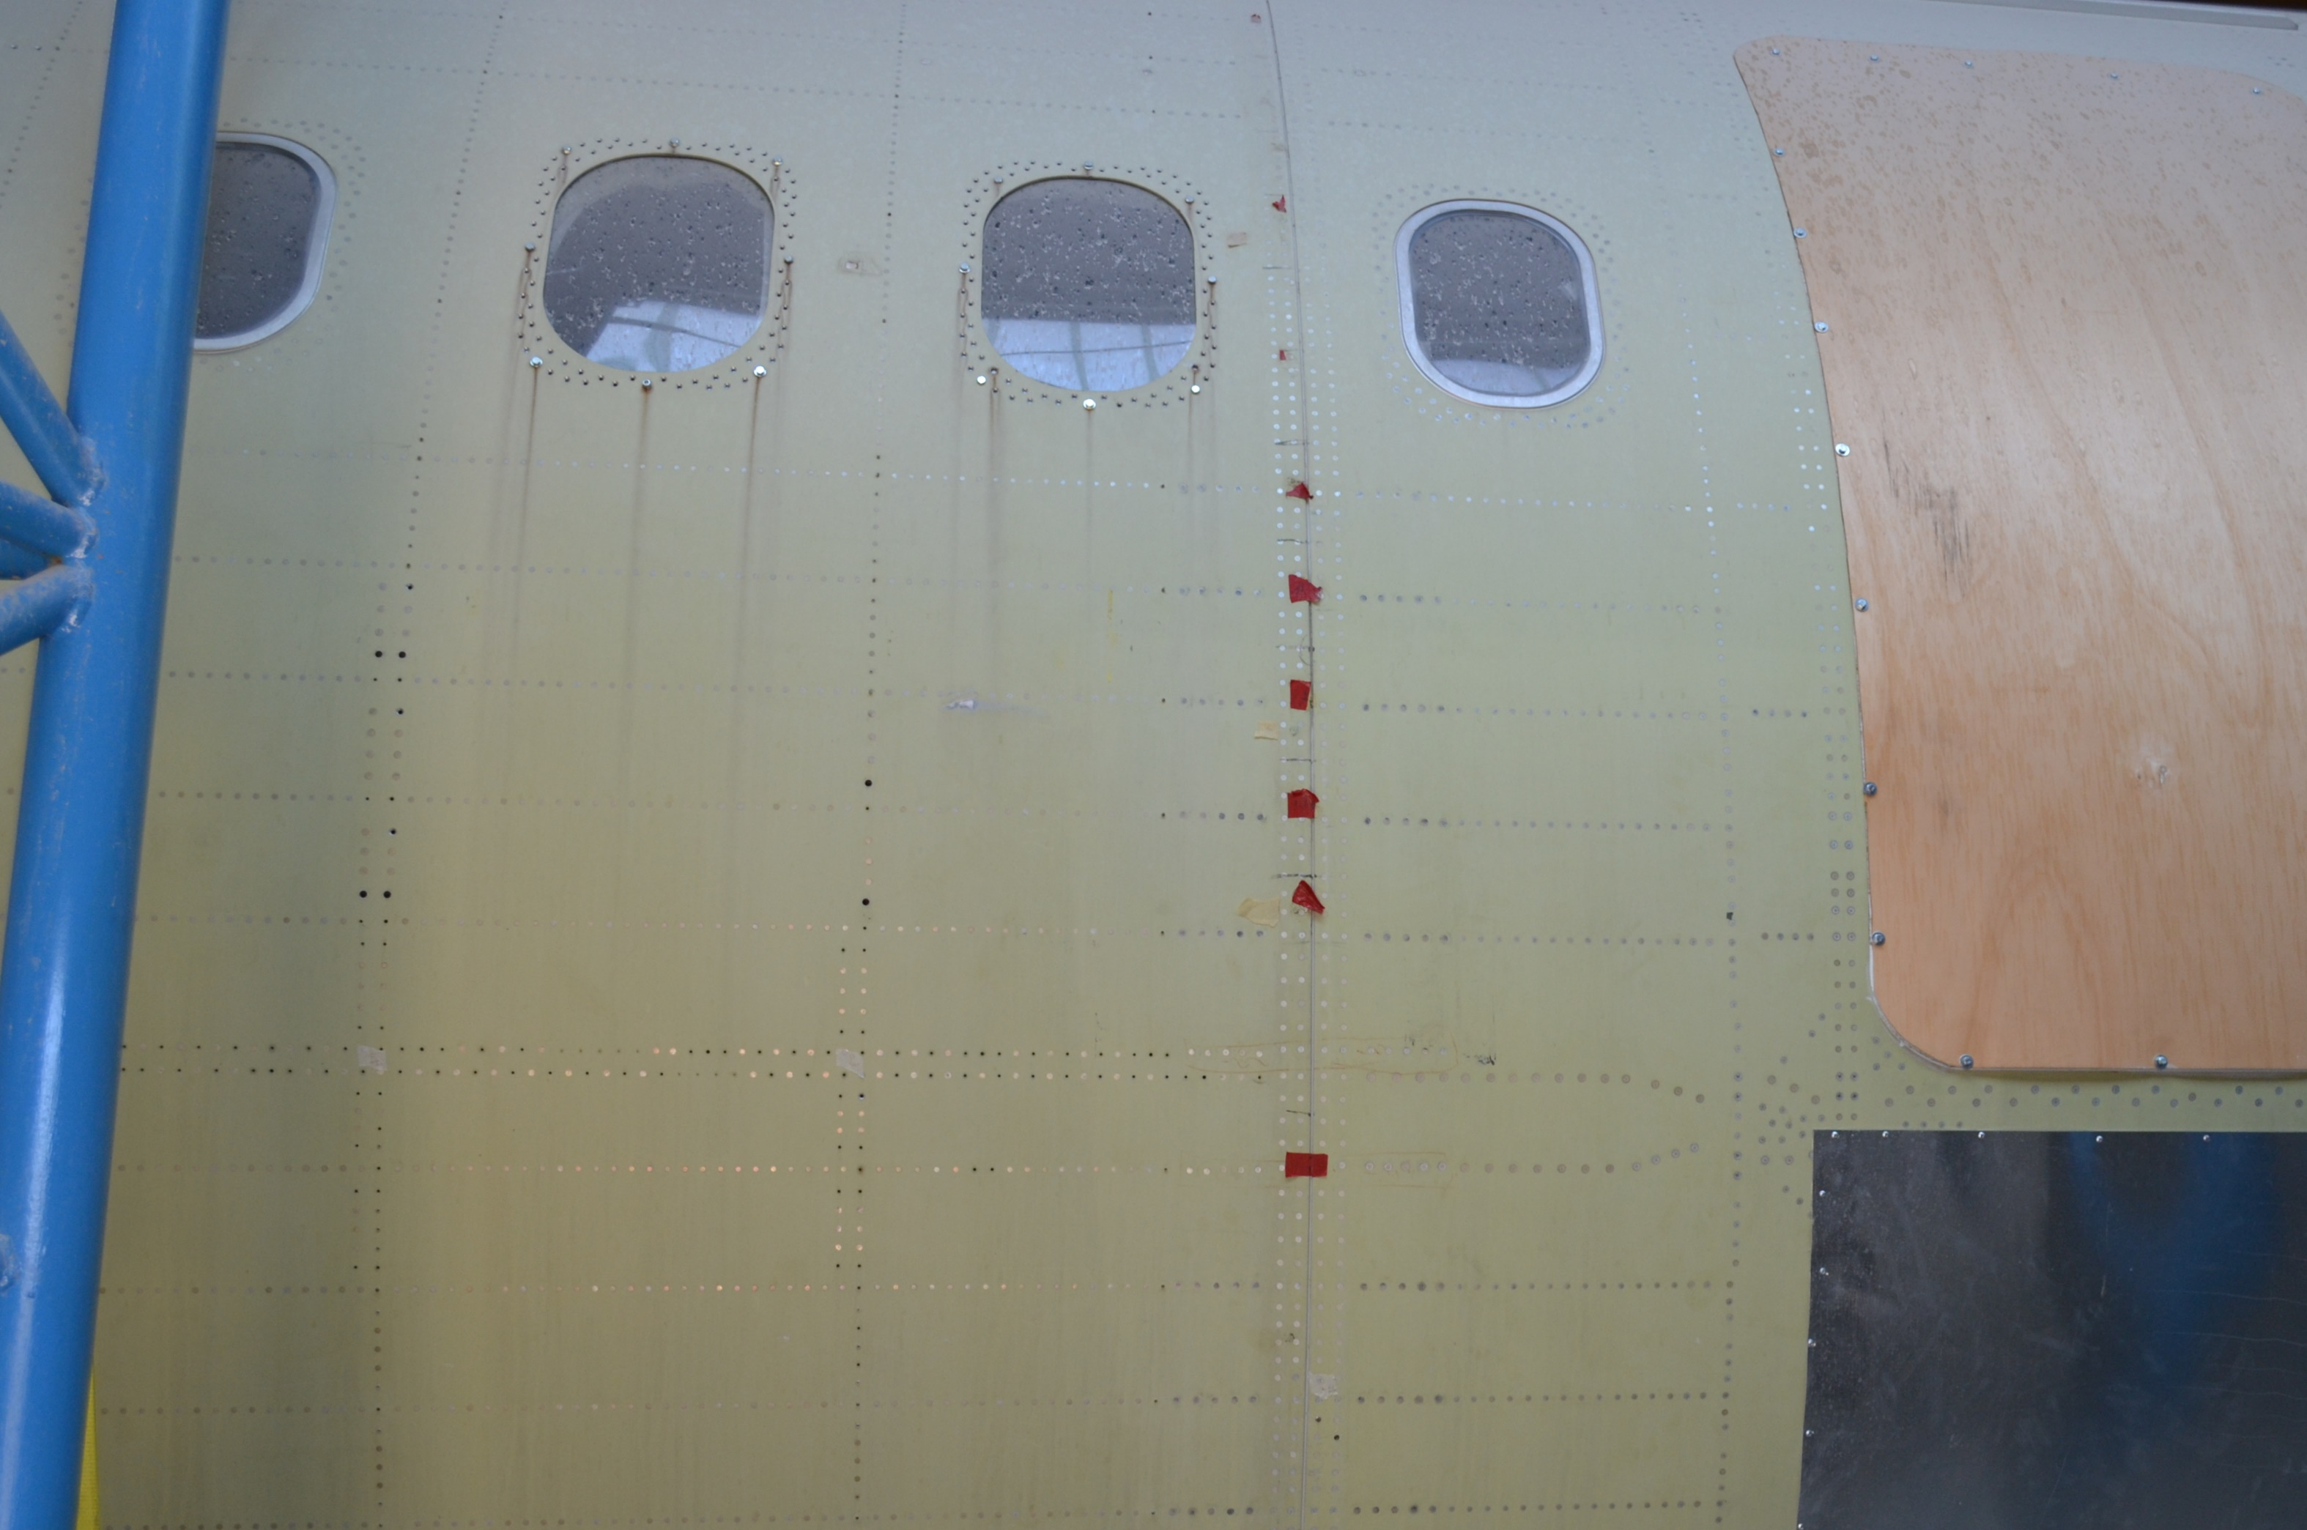
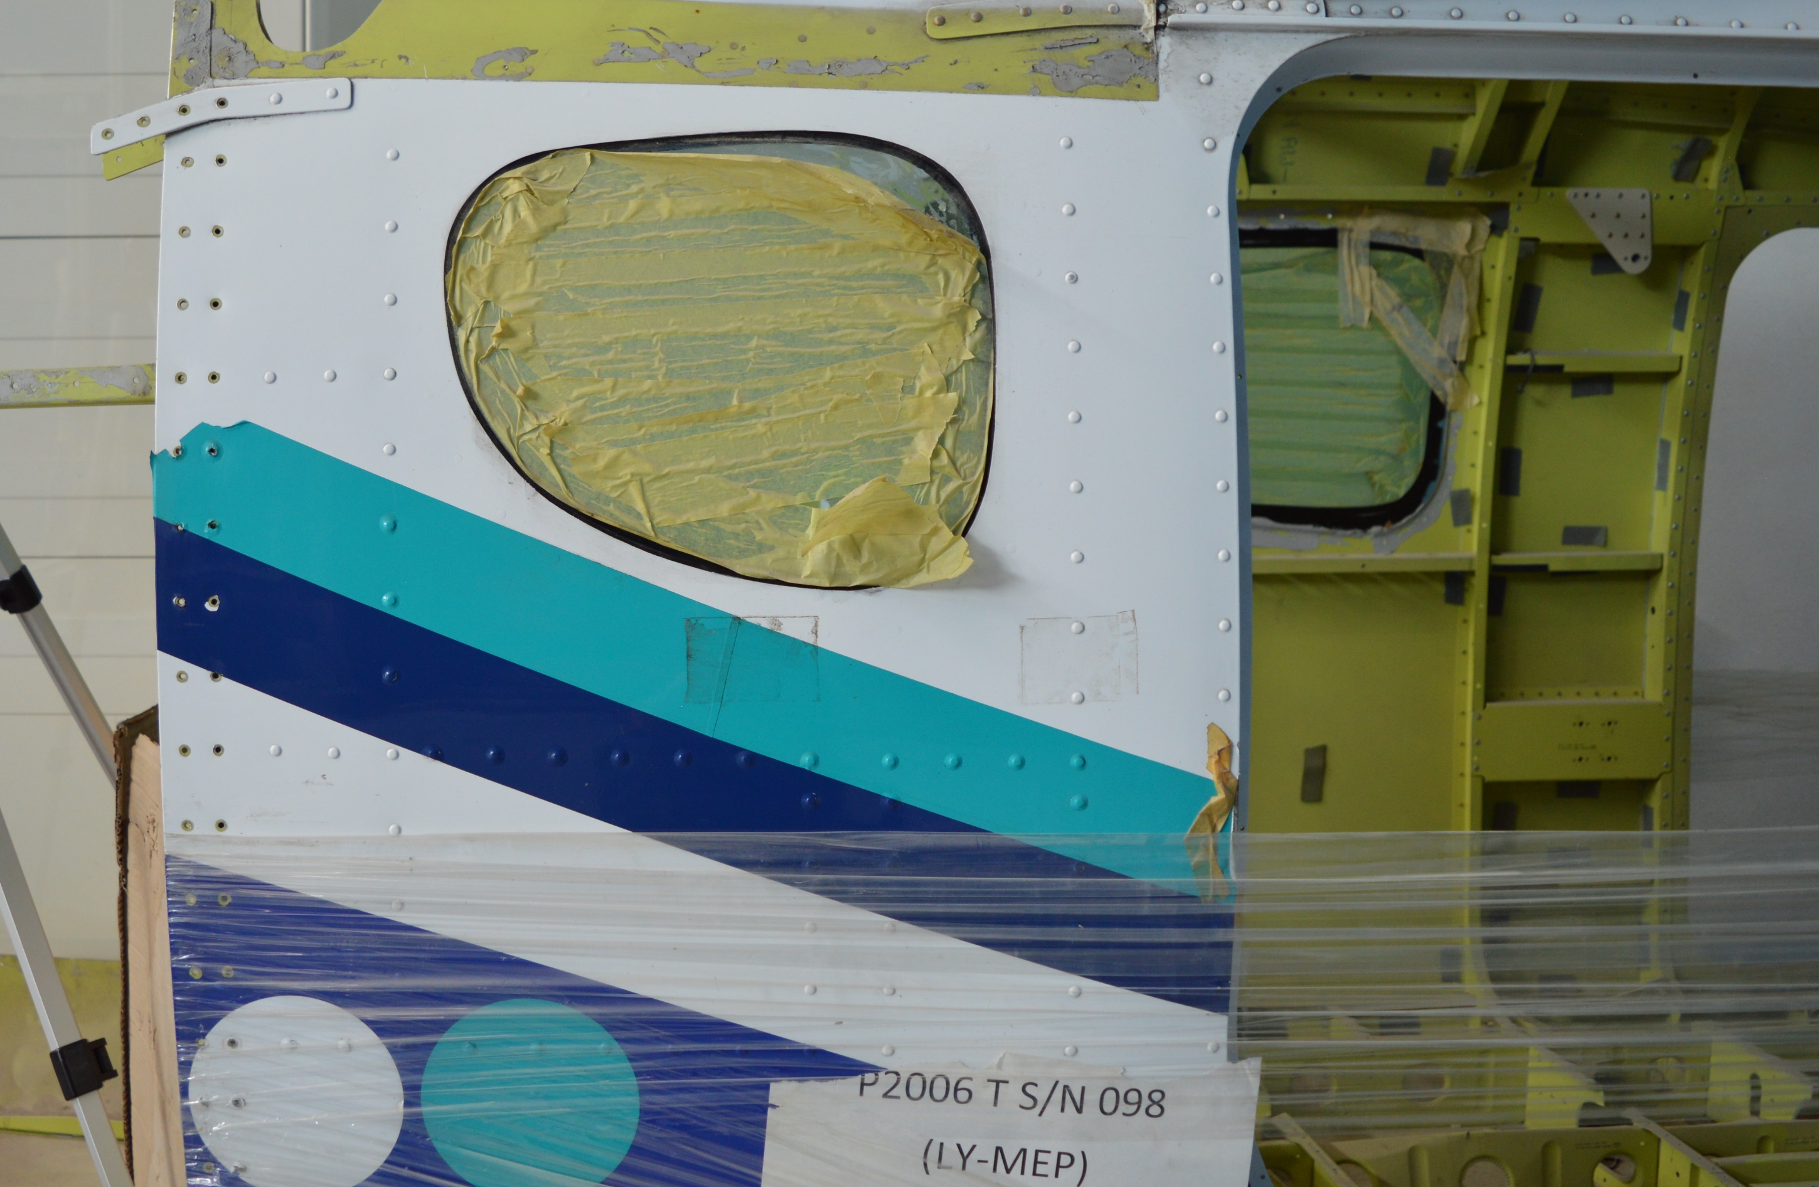
Database creation for training phase
Damage detection algorithm
Database | Condition | Missing rivets (n. of images) | Corroded rivet (n. of images) | General damage (n. of images)
Images from a full-scale fuselage section of a general aviation aircraft in white paint | Light | 60 | 19 | 33
 | Low light | 51 | 20 | 23
 | Blurred | 80 | 79 | 47
Images from a full-scale fuselage section of a commercial aviation aircraft in primer paint | Light | 74 | 34 | 12
 | Low light | 143 | 15 | 13
 | Blurred | 208 | 22 | 31
TOT. images for each defect |  | 616 | 189 | 159
TOT. database’s images |  | 964
full-scale fuselage section of a commercial aviation aircraft in primer paint
full-scale fuselage section of general aviation aircraft in white paint

Slide 23
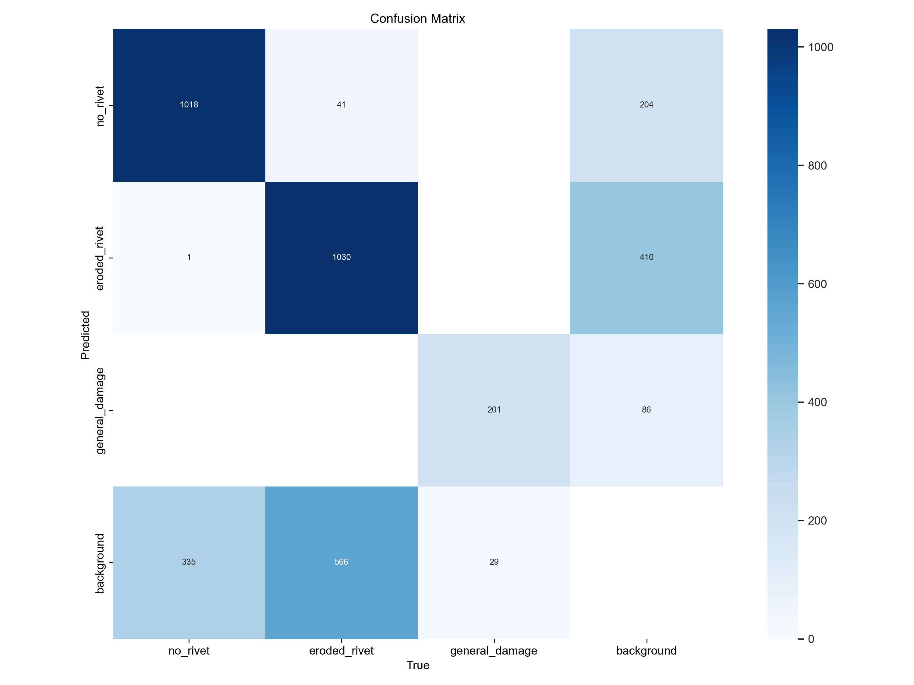
Training options for YOLO algorithms
Damage detection algorithm
N. of classes | 3 (eroded_rivet, no_rivet, general_damage)
Training algorithm | ADAM (adaptive moment estimation)
Batch size | 16
Initial Learning Rate | 10⁻⁶
Epochs | 50
Training dataset | Approximately 6000 ROI
1018
41
204
1
1030
410
201
86
These ROIs include "noise" damage to make the network more robust.
Training Process
335
566
29

Slide 24
Training process

Slide 25
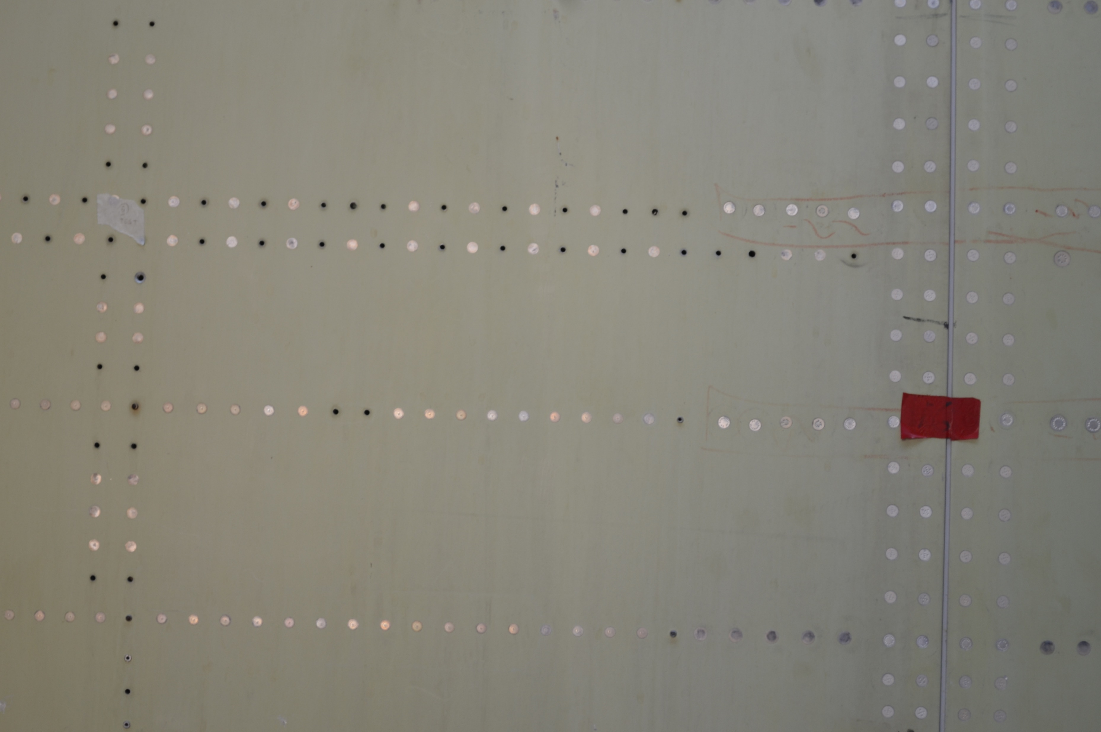
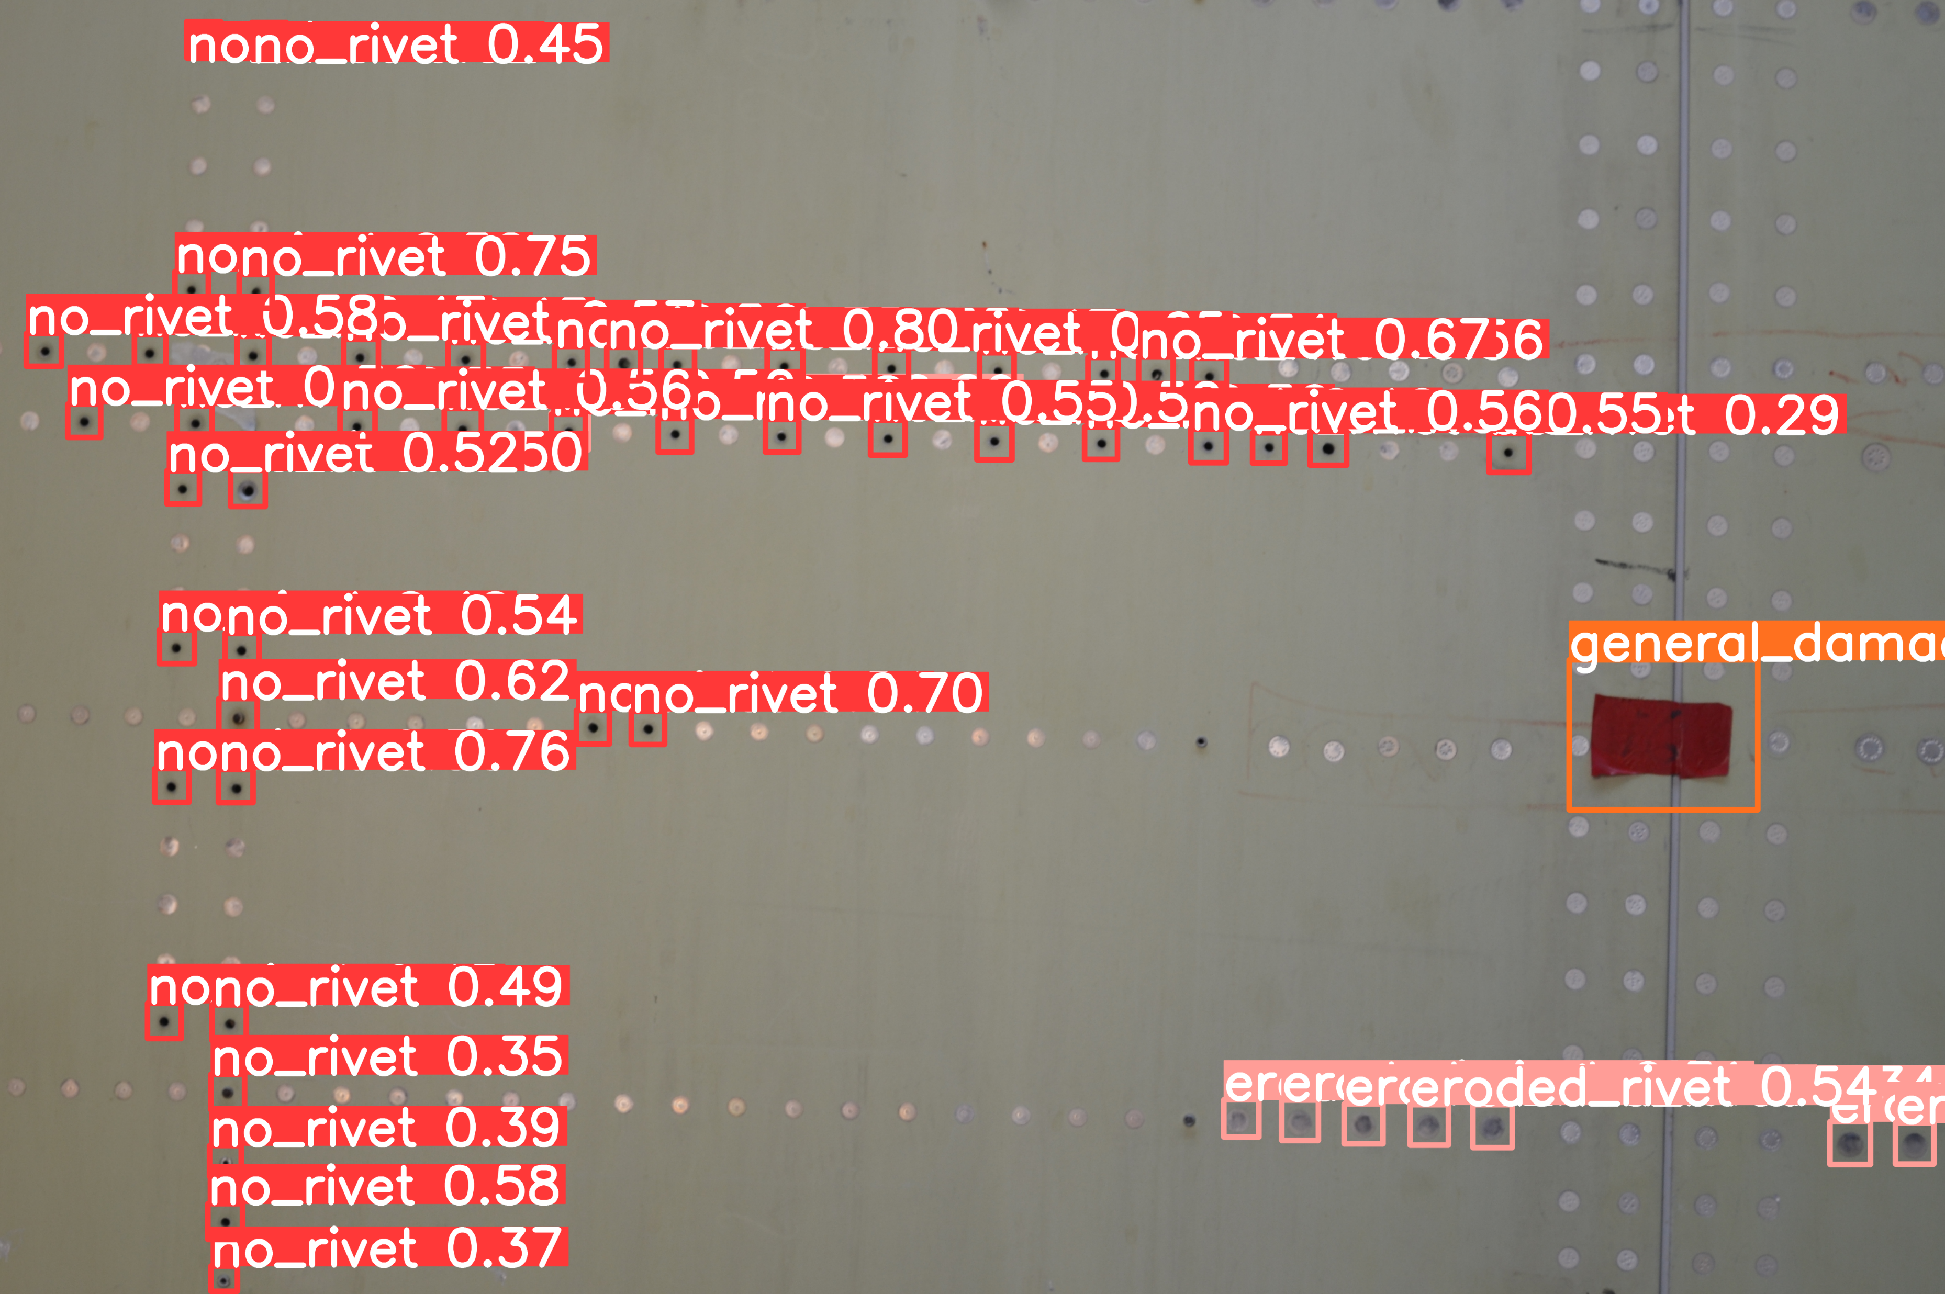
Results from testing phase
Damage detection algorithm
Test image 1 before processing
Test image 1 after processing

Slide 26
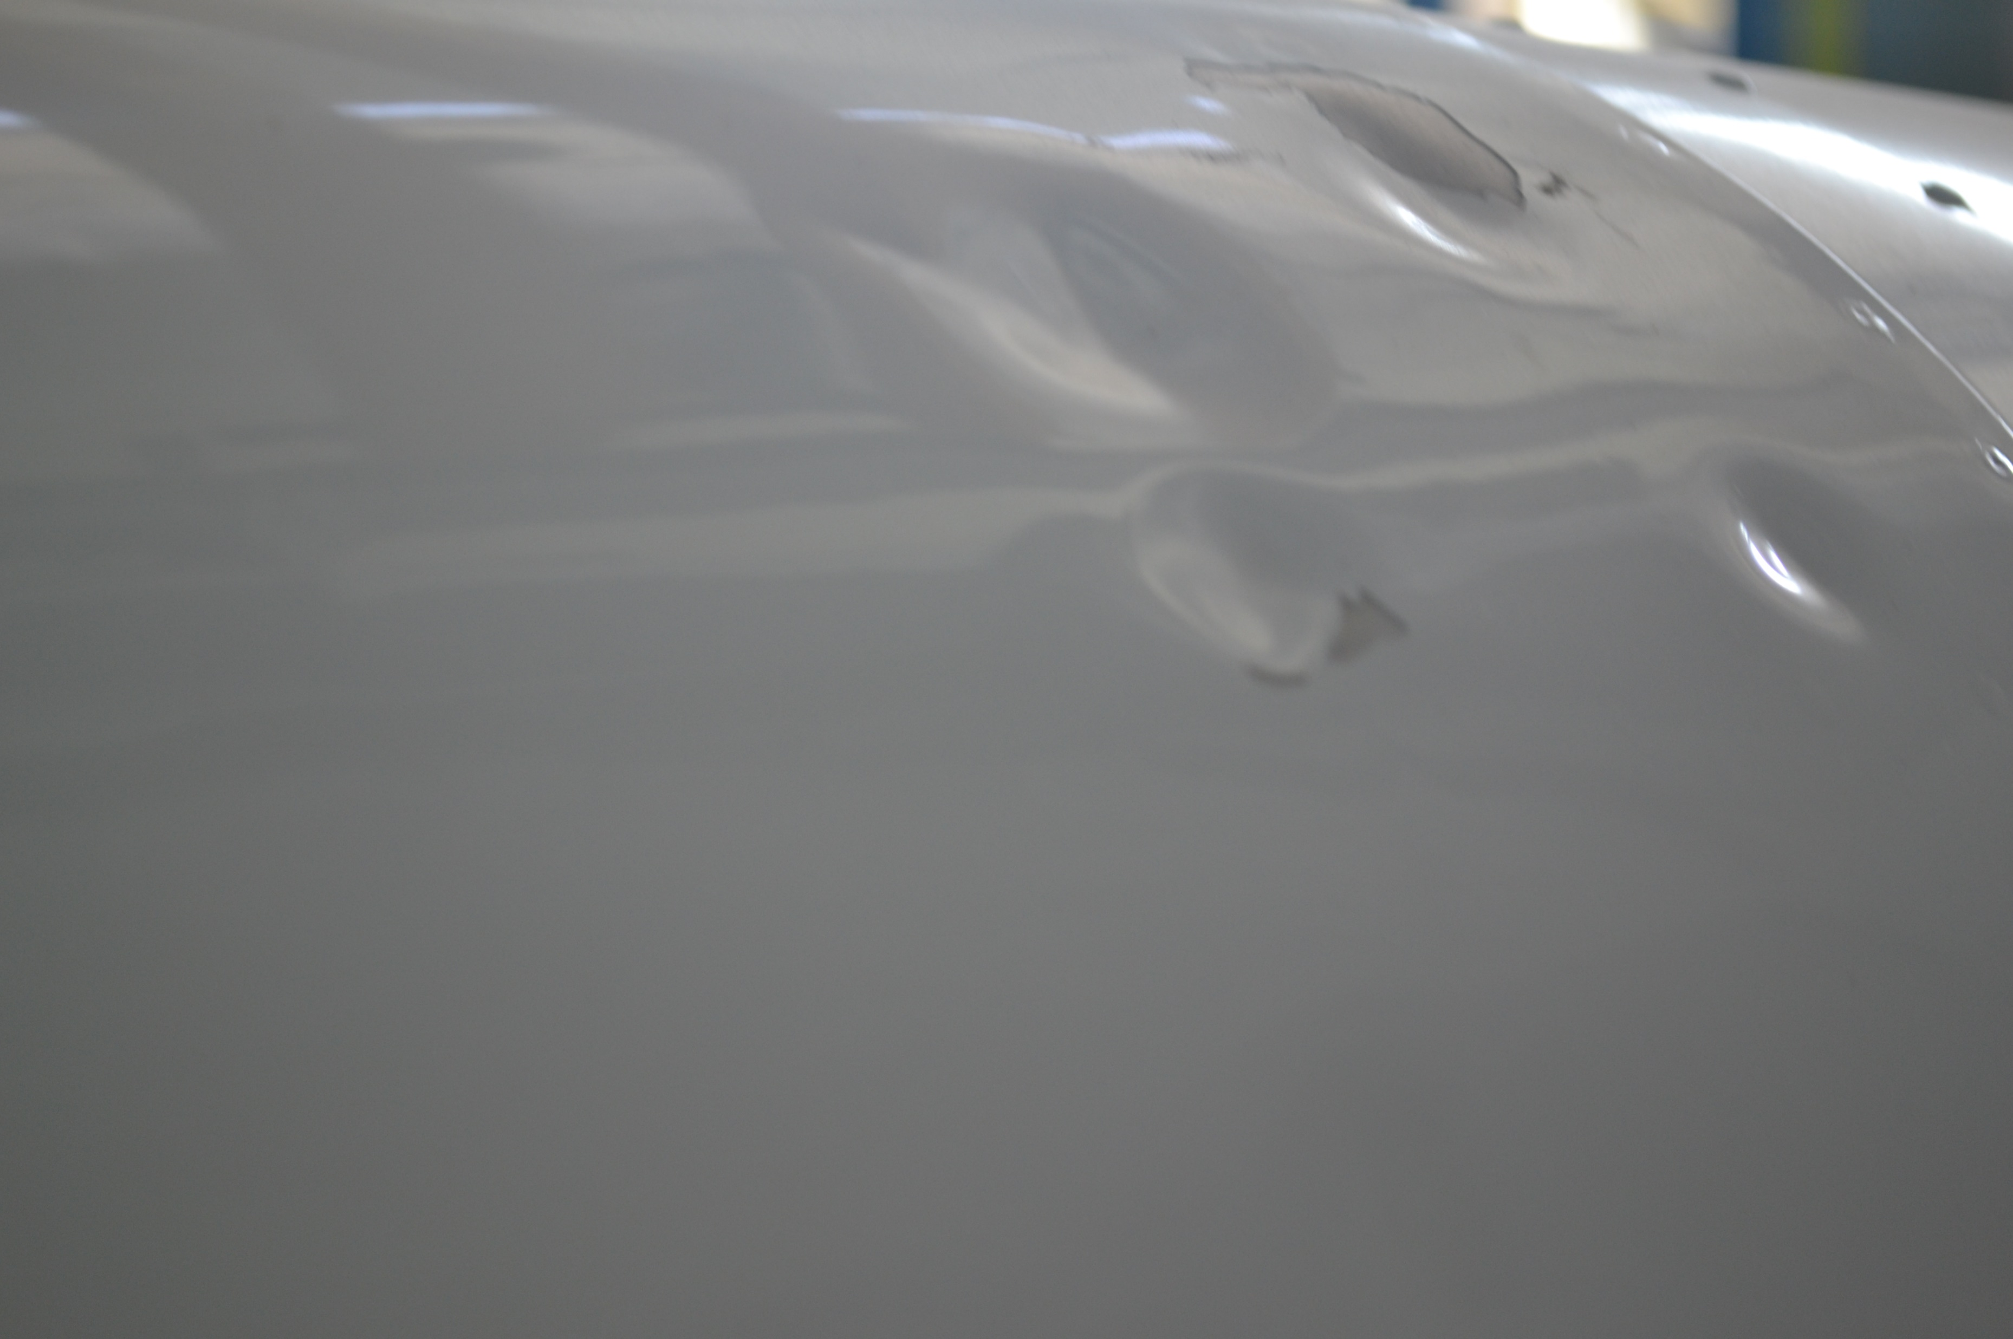
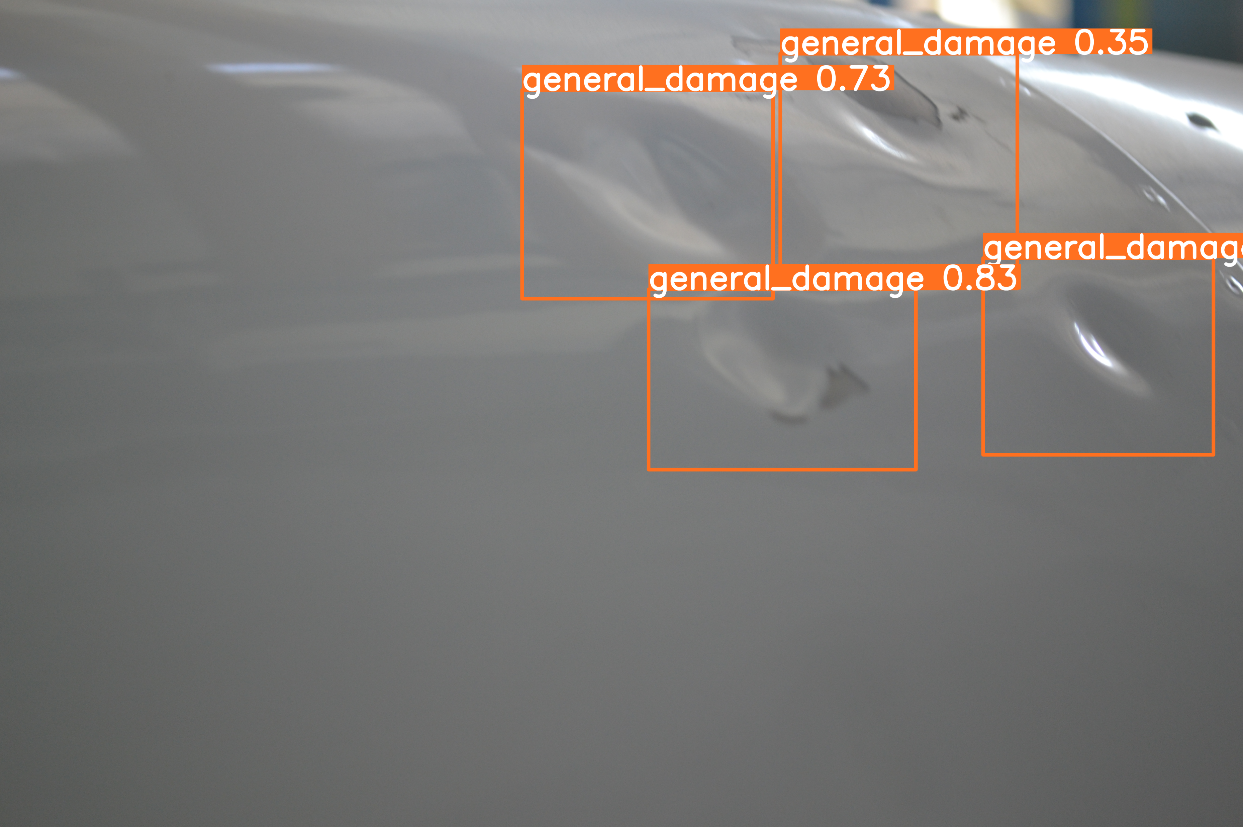
Results from testing phase (cont.)
Damage detection algorithm
Test image 2 before processing
Test image 2 after processing

Slide 27
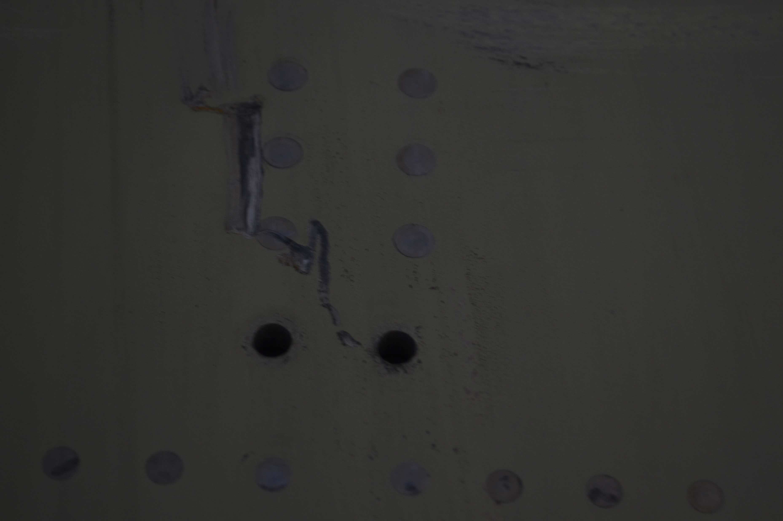
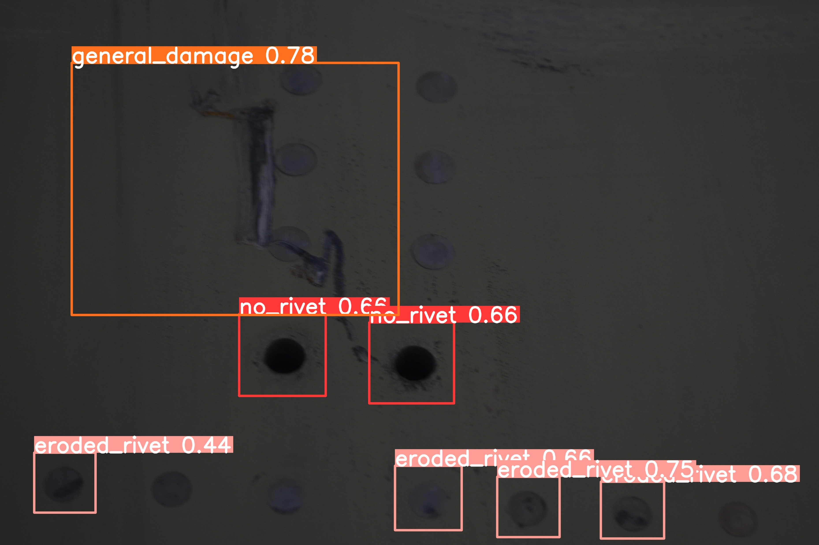
Results from testing phase (cont.)
Damage detection algorithm
Test image 3 before processing
Test image 3 after processing

Slide 28
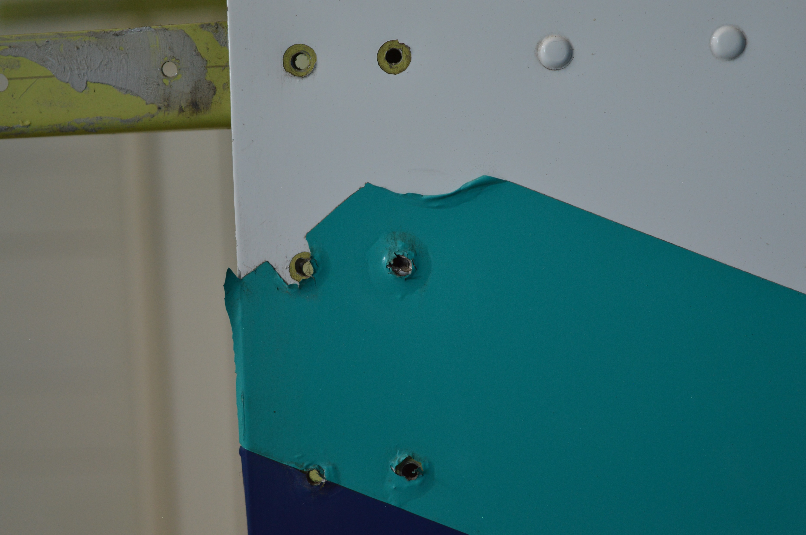
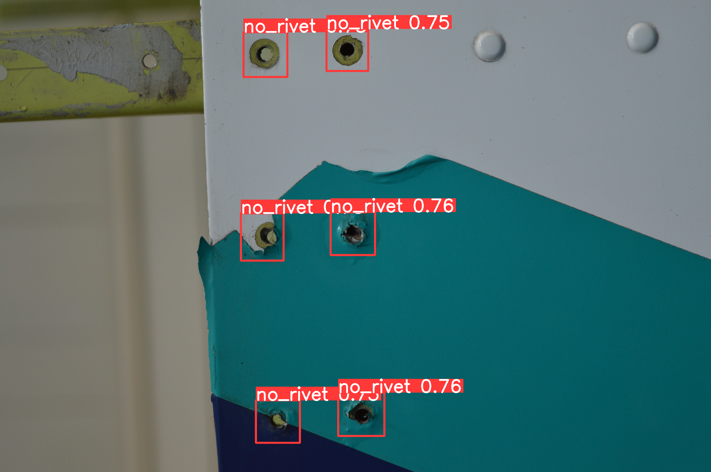
Results from testing phase (cont.)
Damage detection algorithm
Test image 4 before processing
Test image 4 after processing

Slide 29
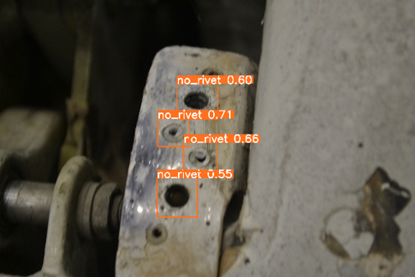
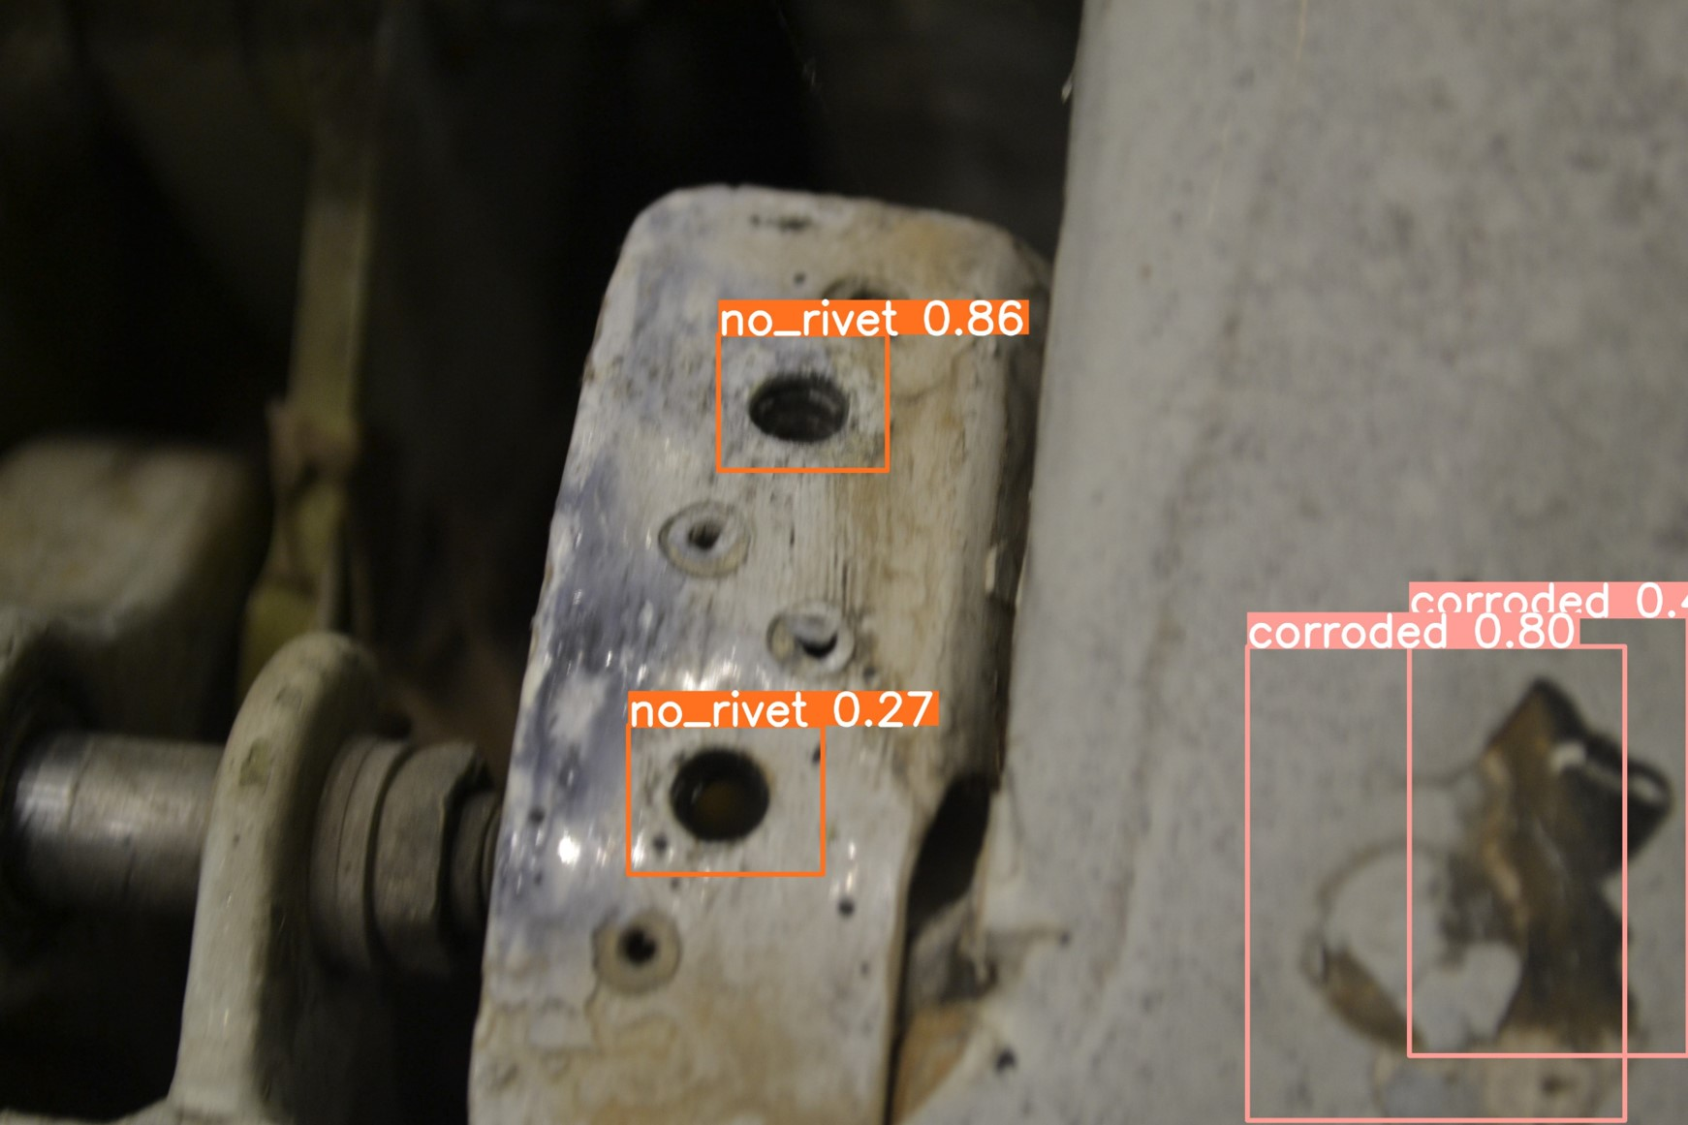
Effect of n. of epochs on training phase
1st training epochs: 100
2nd training epochs: 1000
- Misclassification (good rivets classified as missing rivets, with an accuracy > 65% )
- Corrosion not detected
- No Misclassification
- Corrosion detected

Slide 30
More examples

Slide 31
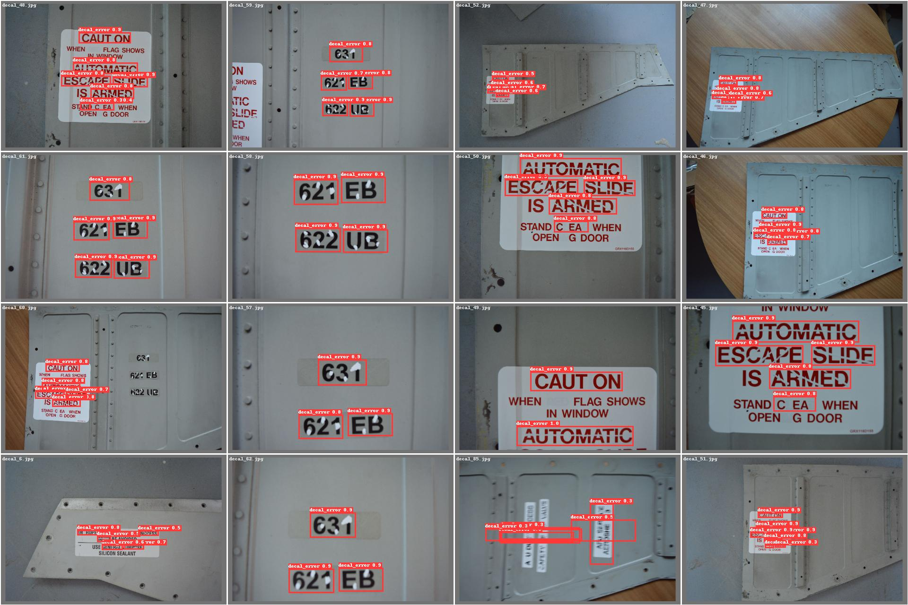
More examples
Errors in decal

Slide 32
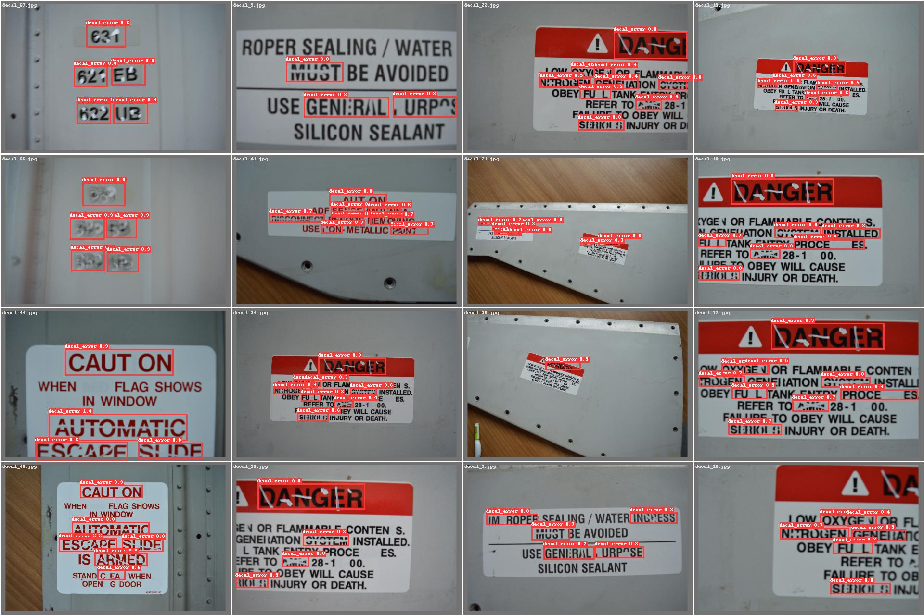
More examples
Errors in decal

Slide 33
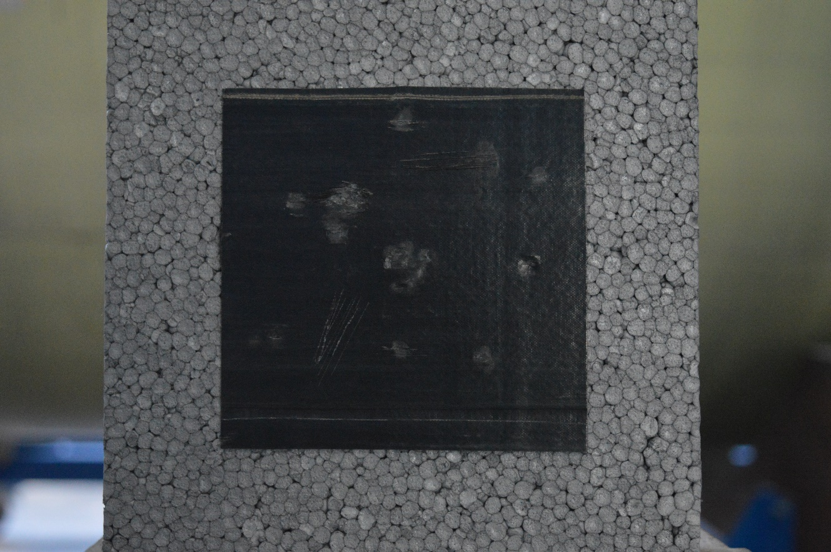
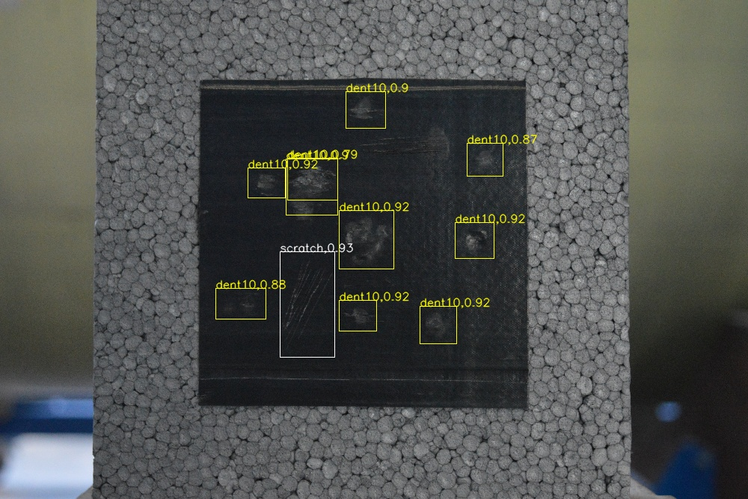
More examples
Damages on composite panels
Test 1 (No light, 90 deg angle, high-definition)

Slide 34
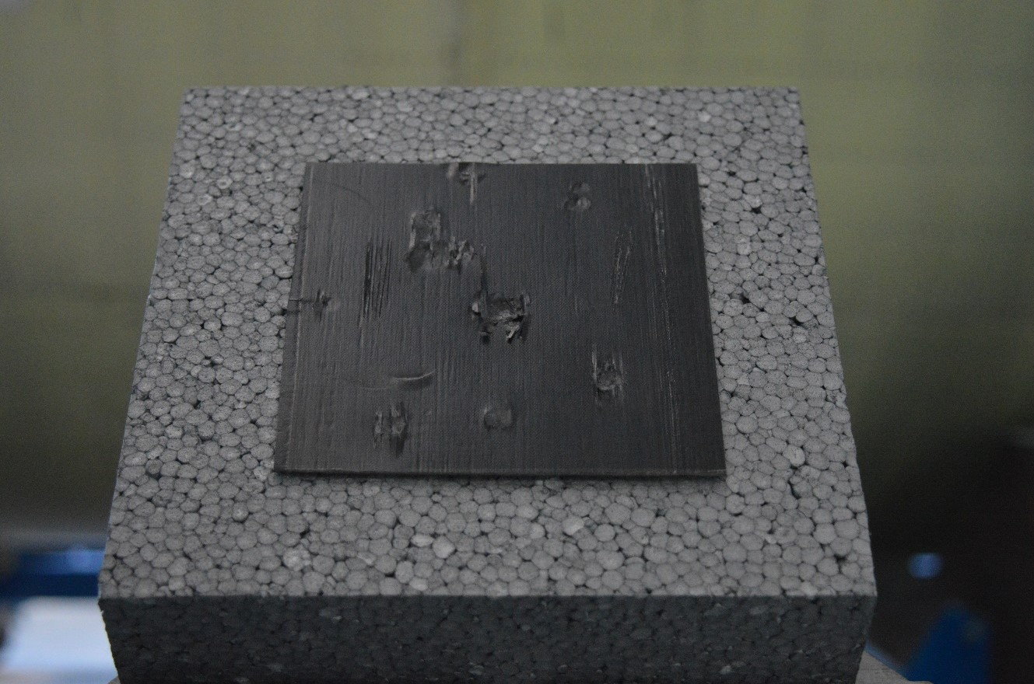
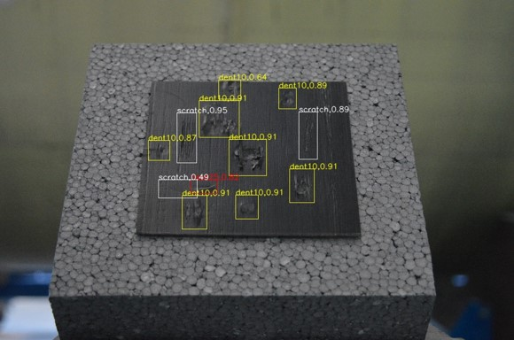
More examples
Damages on composite panels
Test 2 (No light, 45 deg angle, high-definition)

Slide 35
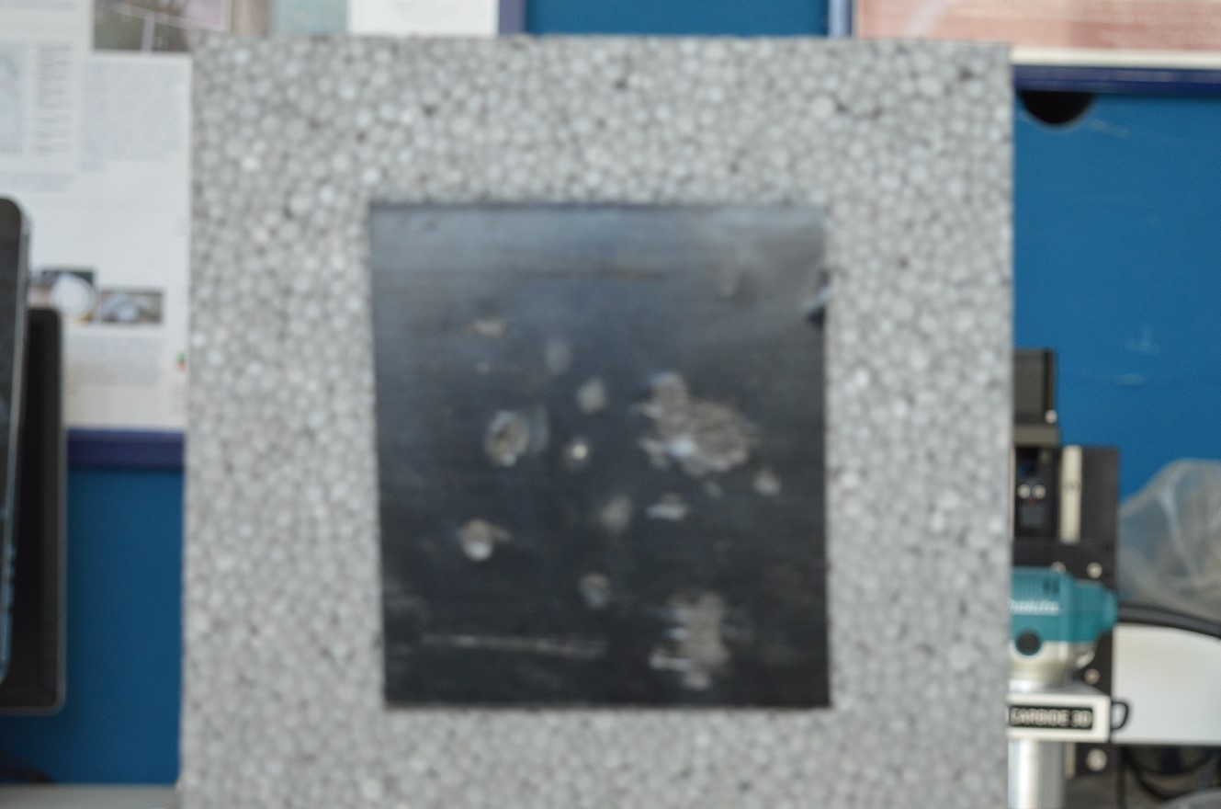
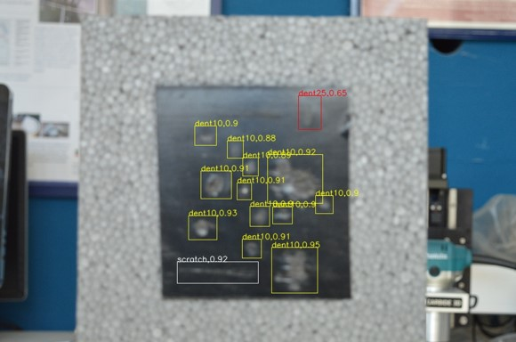
More examples
Damages on composite panels
Test 3 (Light, 90 deg angle, low-definition)

Slide 36
And in the “future”…?

Slide 37
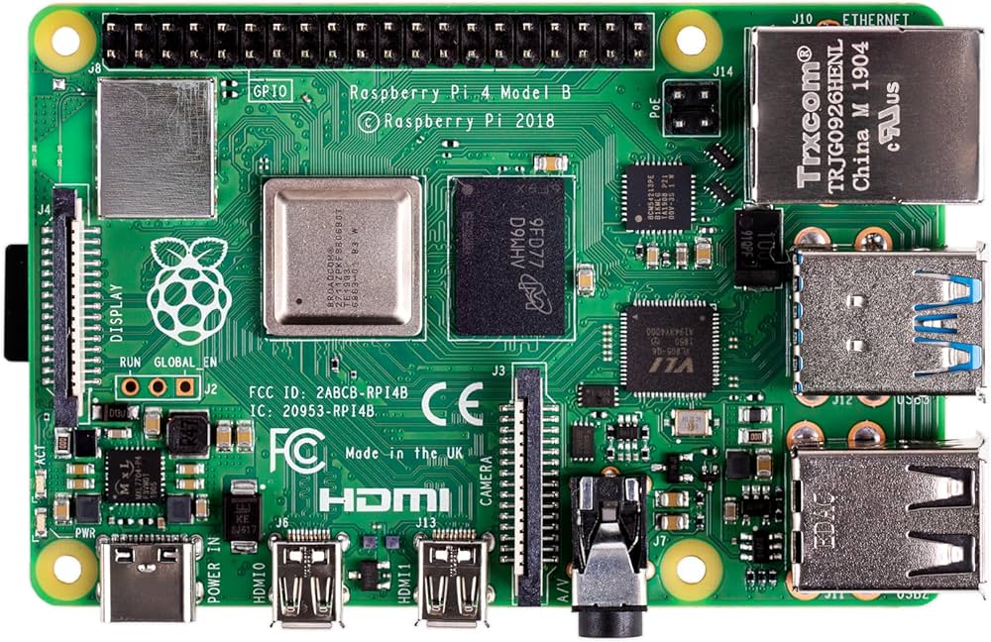
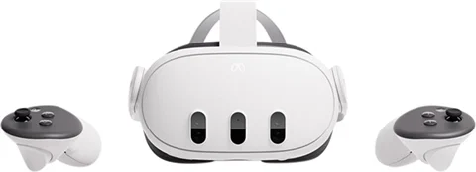
Future Developments

Slide 38
Thank you
for the attention
Salvatore Merola
Ph.D. student
salvatore.merola@unina.it
savimerola@outlook.it
Department of Industrial Engineering
University of Naples Federico II
Via Claudio 21, 80125, Naples, IT

